Slide 1
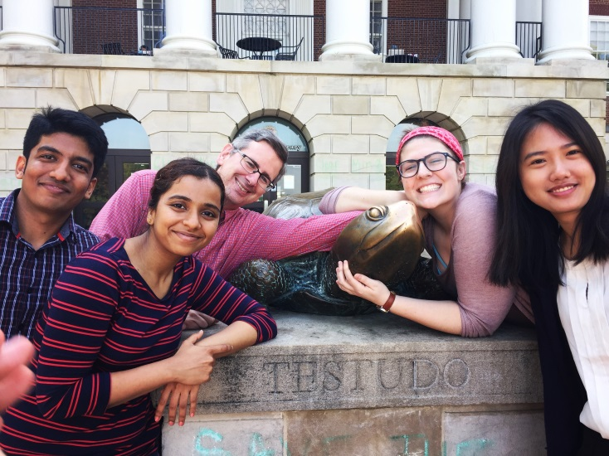
Social Training for Autism using Augmented Reality Final Presentation
The Future of Information Alliance
May 2017

Slide 2
We Are…
Swanand Bhave, Telecommunications Engineering, Clark School of Engineering
Kimberly Martin, Hearing and Speech Sciences, College of Behavioral and Social Sciences
Gregory Schuler, Library and Information Sciences, College of Information Studies
Wenxin You, Special Education, College of Education
Vinita Atre, Human-Computer Interaction, College of Information Studies (Student Team Consultant)
Faculty Mentor: Gulnoza Yakubova, Ph.D., Special Education, College of Education

Slide 3
We Won! Now What? From Proposal to Action
January 2017
Planning and Developing the Content
February 2017
Starting the Development of the Application
March 2017
April 2017
May 2017
Application Development
Exploring the Use of the Application
Emerging Themes from the Usability of the AR Application and Presentation
We need to transform a proposal into a product. That means building an Augmented Reality (AR) mobile application that will help adolescents with autism spectrum disorders (ASD) practice their conversational skills.
What do we need to do?
Organize the team and assign responsibilities
Create the content
Build out the technical infrastructure and begin AP development
Engage our external partner, the Barrie School, and define their involvement
Find adolescents with ASD willing to use the AR application

Slide 4
Creating the Content
Research into best practices and current trends in teaching adolescents with ASD
General teaching methodology for adolescents
Specific learning methods for students with ASD
Collaborating on writing the content
Developing the script and conditions for the application
Looking for the useful combination of age-appropriate interaction and providing value
Engage with Barrie School for age-appropriate interaction and design collaboration

Slide 5
Augmented Reality
Building an Integrated Development Environment
Selecting the appropriate infrastructure
Researching the current best practices in AR
Learning a new realm of technology
AR is developing rapidly
Diversity of uses but still nascent and many unknowns to navigate
We are not a gaming studio
Implementing a new technology for a specific application

Slide 6
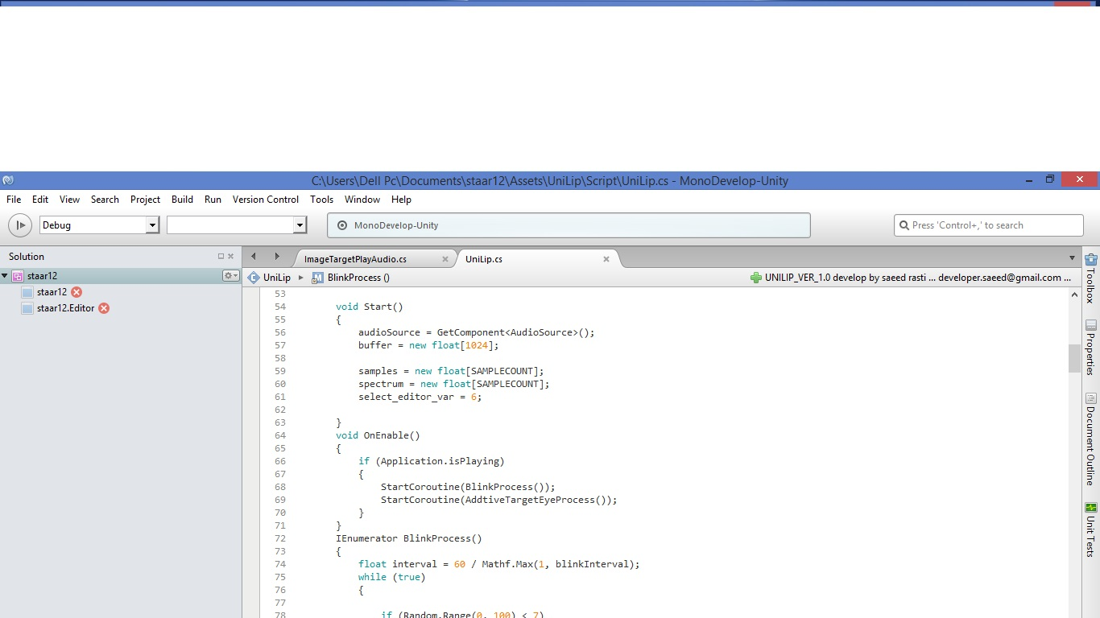
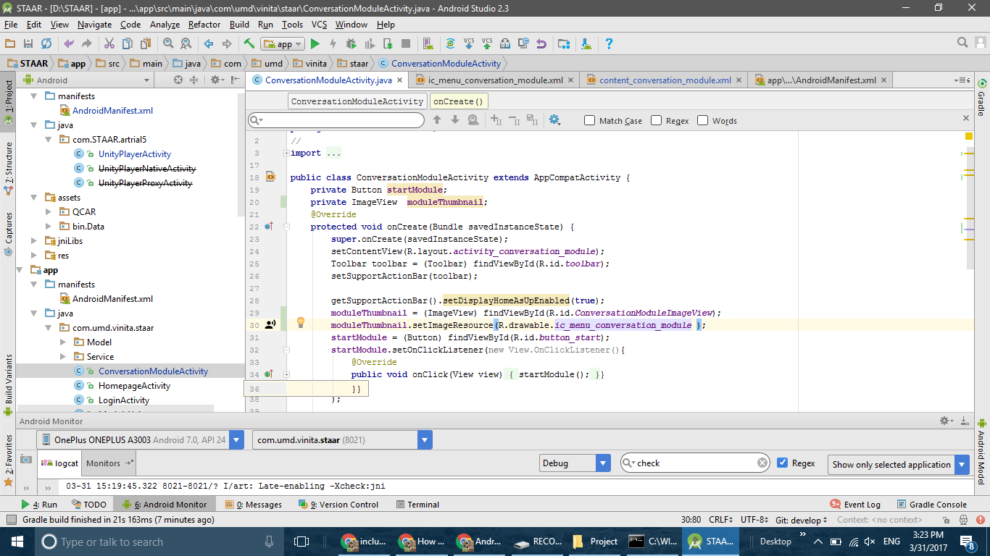
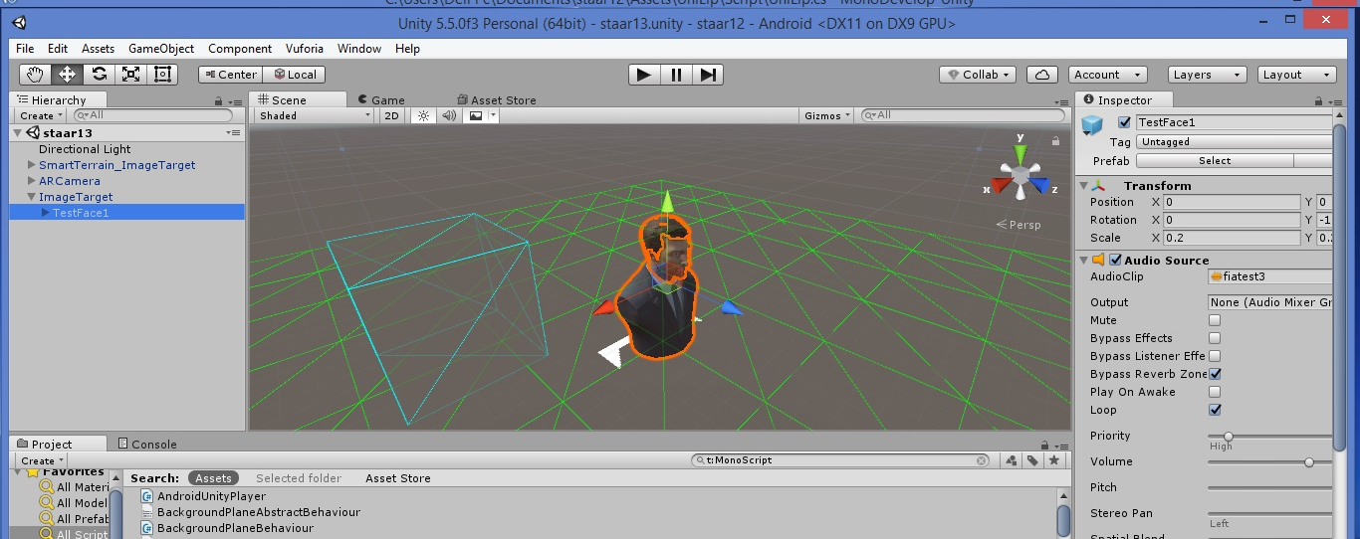
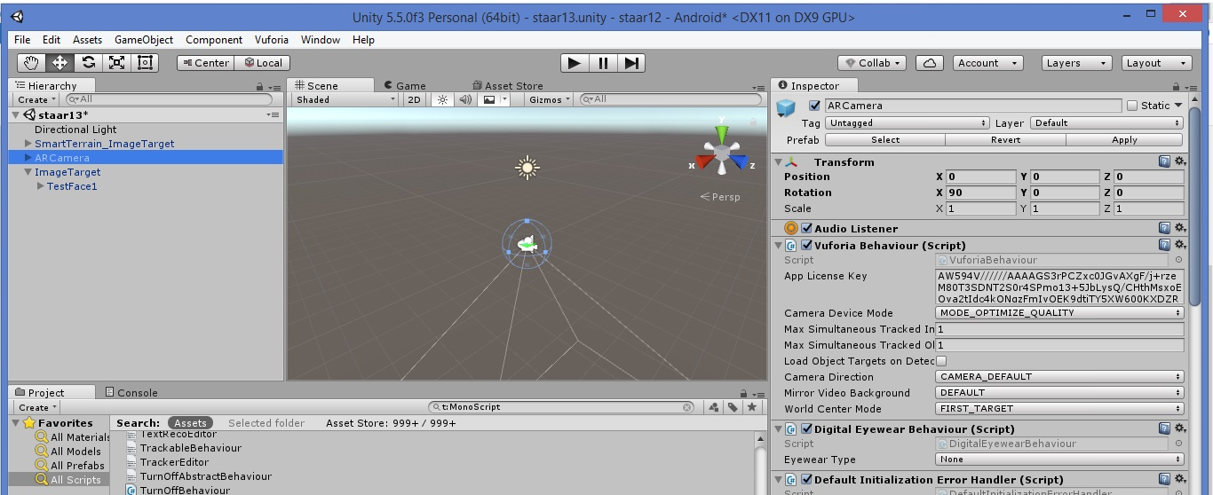
Augmented Reality (continued)

Slide 7
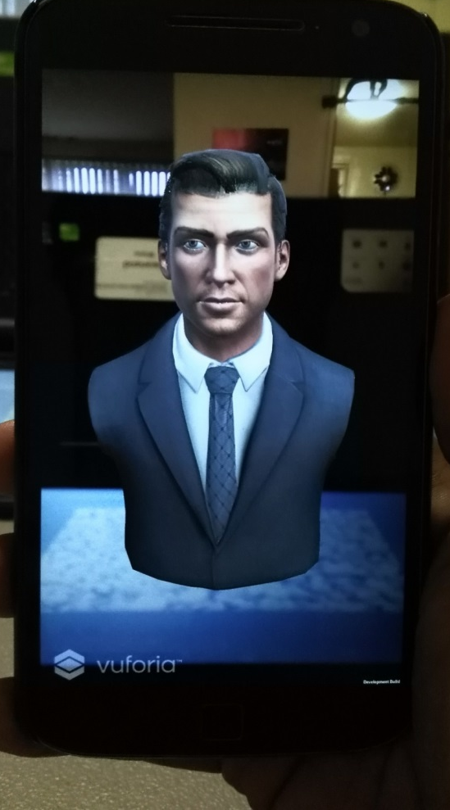
Integrating Learning Objectives into the AR application
How do we take the scripts and build them into the AR world?
Collaboration between content experts and software development experts
Conditions, conditions, conditions
Turning the content/scripts into algorithms and workflows
How to anticipate every response a user might speak?
Providing feedback and encouraging use
Prompting the user the right way
Overcoming technical issues
Bridging the gap between new technology and learning

Slide 8
Testing and Test Results
Five adolescents with ASD
Teenagers wanted to jump ahead faster than we anticipated
Comparing Pre- and Post-tests
Eye contact increased
Body posture towards partner increased
Responding with relevant information increased
Four of the five adolescents were comfortable interacting with the avatar
One adolescent needed more time to understand a new technology and what AR was and needed scaffolding to introduce him to using the AR application

Slide 9
Lessons Learned
Planning and more planning
AR is emerging and it takes time to master
Building an infrastructure and adapting to a new platform takes time and the ability to implement changes must be managed
Scale appropriately
Finding the right way to integrate the AR application is very important
Design counts
Focused more on content and interaction, but what the user sees and hears is perhaps more critical in the application

Slide 10
Lessons Learned (continued)
Fits well with a famous saying: “If you have met one person with autism, you have only met one person with autism”
Individualize your approach to working or communicating with a person with ASD
Not every student with ASD is familiar with AR technology
Do not assume that everyone knows how to use and is comfortable with the technology
Thus, gradually introduce the student to the AR application and model the use of the application to the users
Get their feedback and contribution to the design of the AR application to appeal to the users
Fits well with a saying: “No speaking about autism without people with autism”

Slide 11
Acknowledgements and Thanks
Vinita Atre

