Slide 1
MemoryLoci
Merging Simonides’ Method of Loci with Virtual Reality

Slide 2
The Problem
Vast amounts of material yet unable to study effectively
Rely on repetition. Short-term memorization
Rote memorization
≠
learning

Slide 3
Our Solution
Easily Build Custom VR Environments
The VR Memory Palace creation platform
Make Memory Palaces Accessible
Make learning fun and engaging

Slide 4
Initial Plan
1
2
3
4
5
Create demo environments
Build web-based editor
Test on all demographics
Iteratively improve product
Validate premise, release public beta

Slide 5
Figuring out the Technology
(+) Widely used, well supported
(+) Team has Unity experience
(+) Quickly create demo rooms
(-) Not easy to export to any headset
(-) Difficult to deploy as a web-editor
(+) Deployable as a web-editor
(+) High fidelity content with external streams
(+) Easily deployable to any headset
(-) Not easy to export to any headset
(-) Difficult to deploy as a web-editor
(-) Relatively new, so not as large of a community/documented support

Slide 6
Updated Roadmap
1
2
3
4
5
Learn BabylonJS
Build a sample room with collision detection and multi-device compatibility
Deploy web editor
Modify editor for enhanced capability
User Testing

Slide 7
Our Progress
1
Created a custom environment in BabylonJS
2
Learned collision detection to trigger actions
3
Deployed application on Google Cardboard and Samsung GearVR
4
Contributed to the BabylonJS community
5
Deployed a website with preliminary editor

Slide 8
Sample Demo

Slide 9
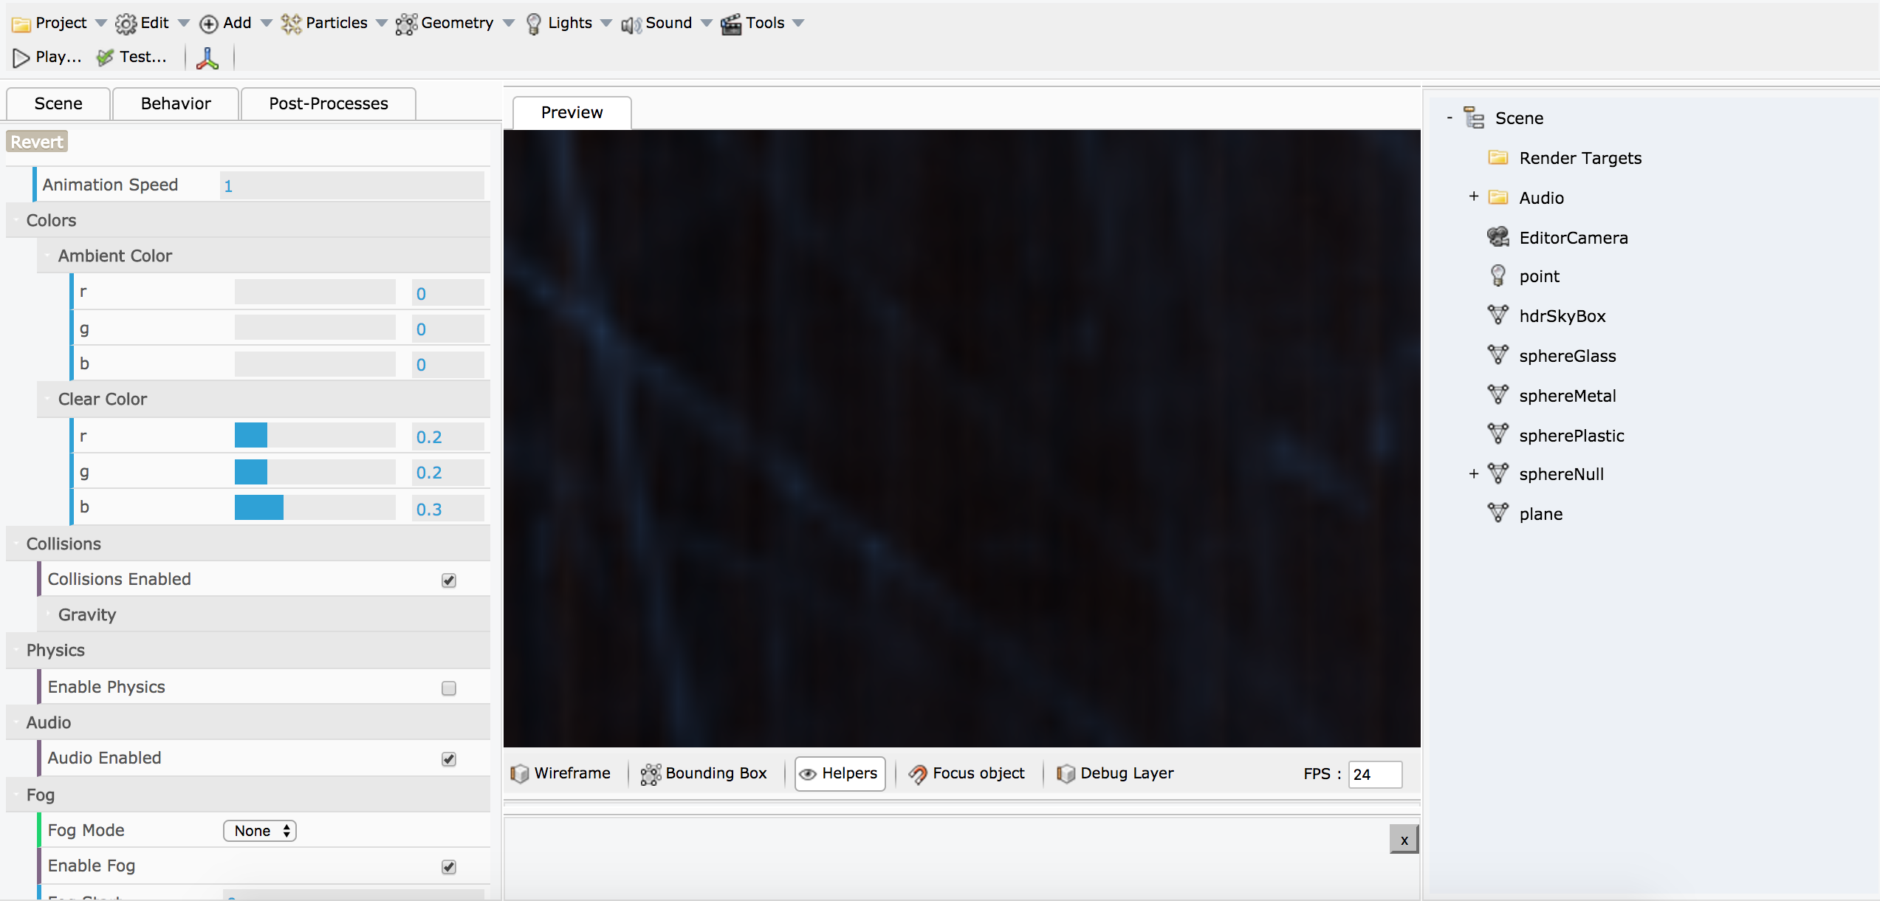
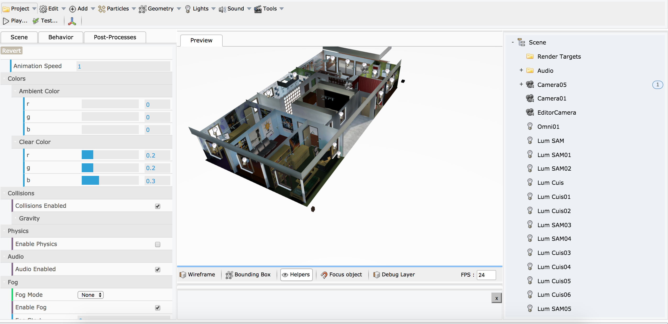
Website – Basic Editor

Slide 10
Lessons Learned
1
Be conscientious of the tools you need, and your experience with them
We were forced to change to something we had little experience in (and there was relatively little support for).
2
Make note of how widely adopted your tool(s) are in the community
Learning a new technology and contributing to it is incredibly rewarding, even if it reduced our scope.
3
Do not go too wide too early
Instead of building for one platform, we focused on creating the same experience for all platforms.
4
Get a demo in the hands of partnered organizations early
That way last minute conflicts don’t prevent you from testing your prototype!

Slide 11
Remaining Work
Expand Editor Capabilities
User Testing and Validation
Public Beta and Beyond
Sample environments
Streamline workflow
Add tutorial overlay
Allow for easy export
Store user data
Testing to evaluate learning goals and product usability/market viability
Continue contributing to the BabylonJS community through our technical findings
Explore our concept in other contexts (information management, clinical education)

