Slide 1
Inside a Washington, DC
Food Desert
Team members: Kelsey Hughes, Naema Ahmed,
Jennie Aguilar & Camille Chrysostom
Mentors: Josh Davidsburg & Sean Mussenden
Notes:
NAEMA: Introduce project:
Hello
Identify team members and mentors, as well as which college they’re from
Today we’re going to talk to you about our project: inside a washington dc food desert

Slide 2
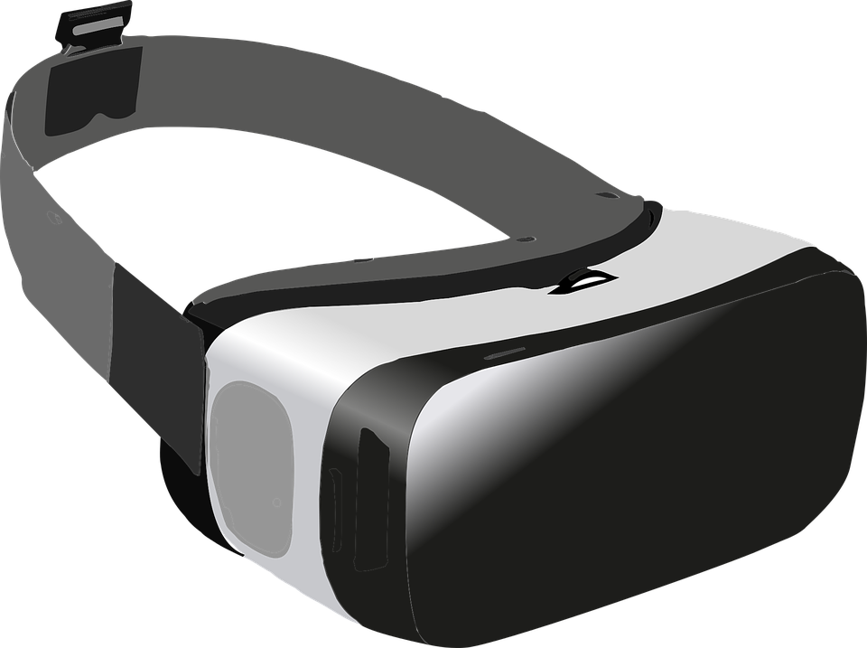
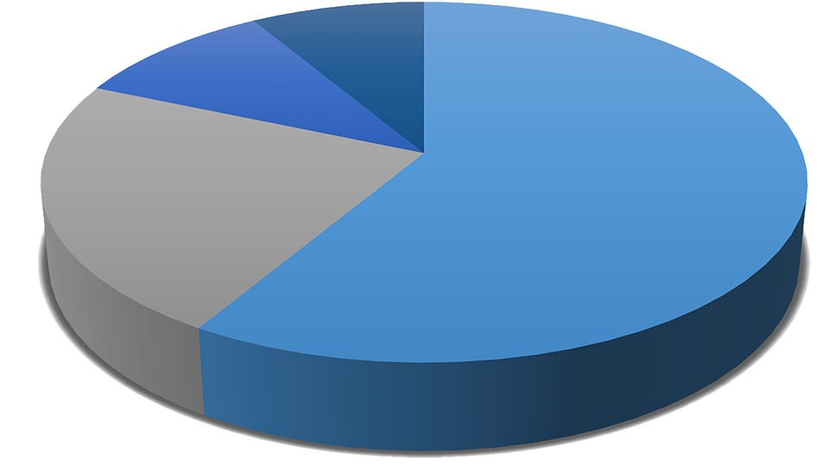
The Project
Notes:
NAEMA:
Credibility is a major issue in today’s society, and AR/VR is an emerging field
How can we merge AR and VR to explore making information more accessible and credible?
360 video experienced in a VR setting shows the full story, creates an immersive experience that allows for greater empathy
Factual data overlaid can help add trustworthiness to the story and thus combine these concepts of accessibility and credibility
Food Deserts a perfect type of story for the intersection of these two concepts because there’s a lot of data surrounding this topic but the human element can’t be ignored

Slide 3
The Process
Notes:
KELSEY:
Started off essentially like reporters would - Identify food deserts in SE DC and approach corner stores explaining what we’re trying to do.
Simultaneously, conduct our own research both on food deserts and also the best tools to use
Visit stores and film - tested a variety of filming methods once we realized following one person around didn’t really work - get into why later
Learned software - show test video
Edited video and added graphics
Using Mettle Skybox
Tried a variety of editing styles and graphics - ultimately 3 different versions, in each one 3 graphics placed 3 diff ways
3 versions: don’t show interviewee, show interviewee, VIAR
3 graphics: 4 different spots in video, arrow pointing to one, no cue
Tested video - not quite

Slide 4
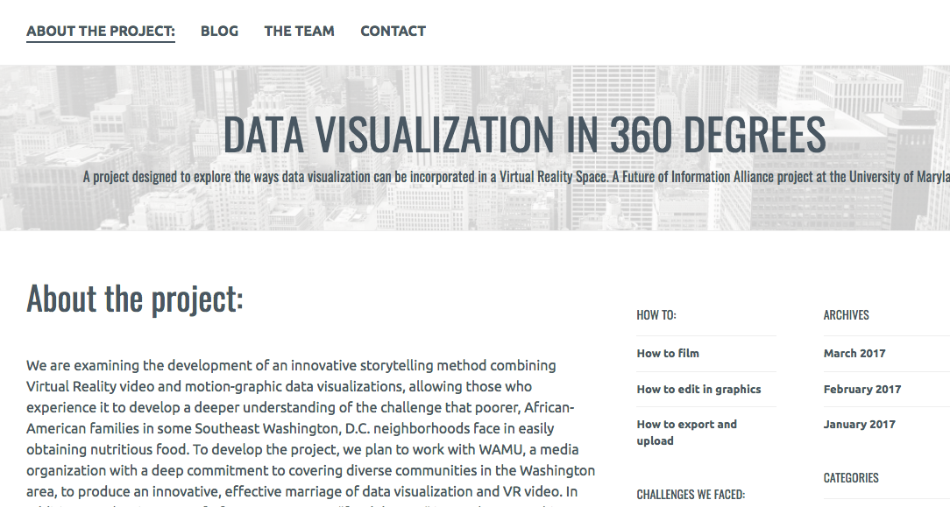
Link
Notes:
KELSEY:
Then we compiled a website: (CLICK LINK)
Included some challenges we faced, as well as a how-to in general to create 360 video with all that we’ve learned
After disc of website, NAEMA will talk through video

Slide 5
The Video link

Slide 6
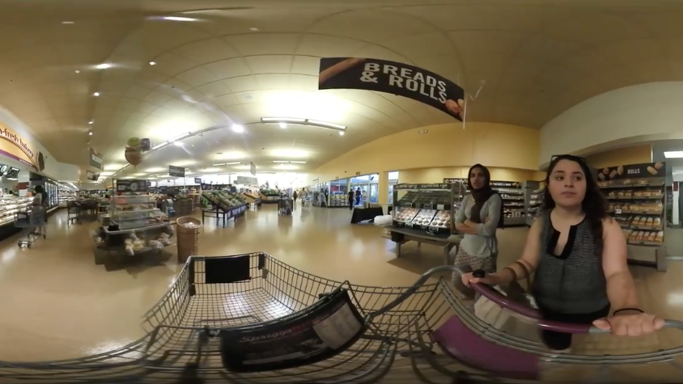
Lessons Learned
Notes:
KELSEY AND NAEMA:
NAEMA: Reporting challenges: normal reporting stuff, people not wanting to have us record them because they were distrustful. Found the 360 camera could kind of help us get our foot in the door
NAEMA: Filming challenges; Our initial idea was to follow on person throughout the store but not only did we not really end up having a person willing to let us follow them around, but we found there was no reliable way to get a steady shot without the reporter in the frame - we do have one moving shot attached to a shopping cart but most of the filming locations were little stores with no carts,
Stabilizing equipment could work but we didn’t have the level of expertise to edit it out
Also - food deserts are really defined by a lack, which we forgot and made filming difficult
KELSEY: Editing challenges: where to put graphics, and how. Also had to learn a lot of technical skills quickly.
How much needs to be shown - want it to be immersive but also want it to be credible - can you believe a person if you don’t see their face
Tenson of traditional reporting package vs. considering new ways of doing things. How much do we want to break away from the tried and true?
Solution we attempted was to not show the person but pop up an image of their face. In retrospect probably should have taken some portraits of them as well so we could have that data rather than relying on screenshots

Slide 7
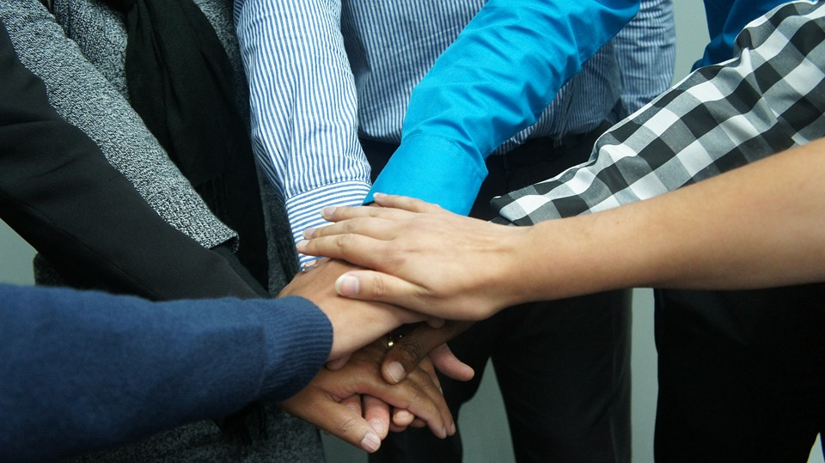
Teamwork
Notes:
KELSEY:
Working with multidisciplinary team
We each had something to contribute and a different role
Kelsey documenter of process, researcher, organizer
Jennie did all the filming and was our editing expert
Her multilingualism also helped us get in with many of the shop owners
Naema was really helpful with the graphics, and she did a lot of reporting
Camille was very versatile and helped fill in on all the various tasks as needed especially research and filming.
Also helpful to have two mentors, as they each had their own perspectives nad backgrounds which they rbought to the table (sean with the digital/graphics and Josh with his 360 experience) and they were able to support us in different ways and engage us in different discsusions

Slide 8
Future Outcomes/Broader Impact
Notes:
NAEMA: Outcomes/broader impact
We have two major deliverables of this project: the videos, and the tutorial website
The videos will be used to conduct further testing and determine what methods of incorporating graphics could work
The website ended up having much more information we intended, more than just about adding graphics - we documented the whole process and challenges involved
Ultimately we want to explore partnerships to get our final video more reach
The site will remain up so that other journalists can explore 360 video
Ultimately we will be able to expand how people think about 360 video and incorporation of data, and move beyond the traditional

Slide 9
Questions?

