Slide 1
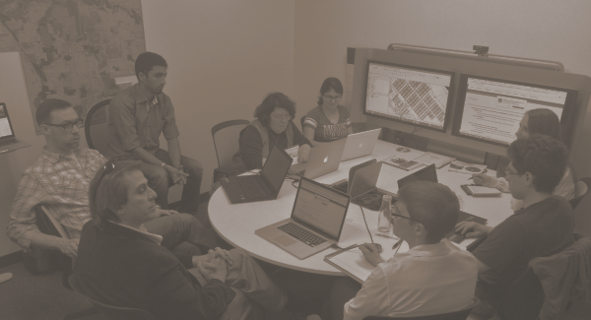
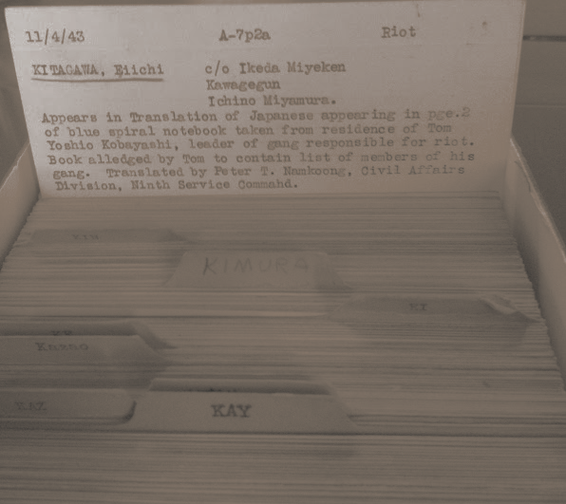
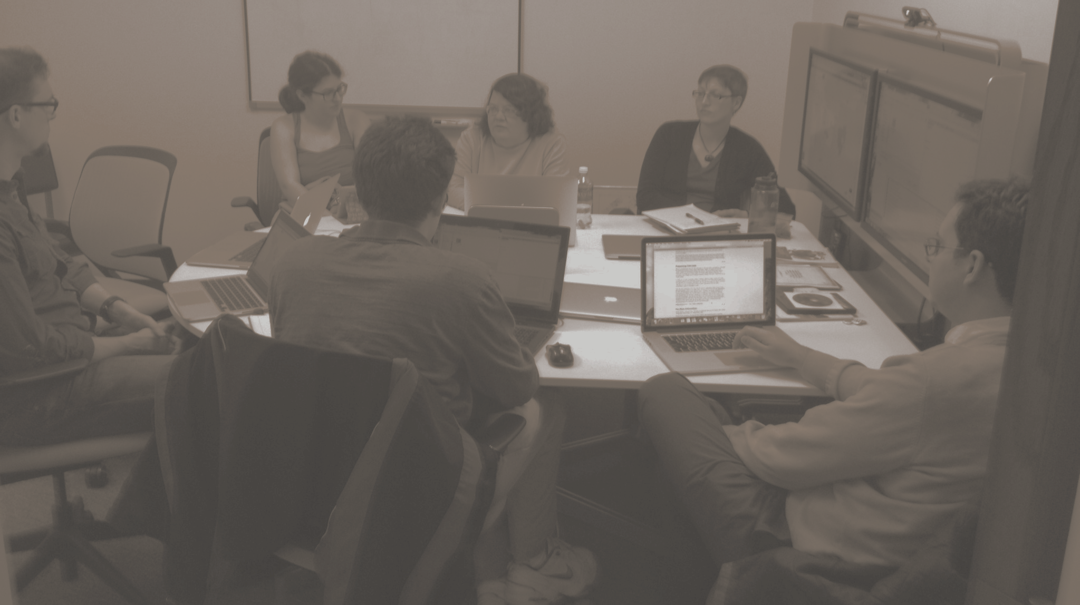





Revisiting Segregation through
Computational History:
The case of the WWII Japanese American Tule Lake Segregation Center
Notes:
Explain what the project is and why this research needs to be tackled (tied to FIA priorities);
From proposal: “We seek to investigate the integration of archival and user-contributed data by proposing to prototype an interface that links people, places, and events from distributed sources related to the Tule Lake Concentration Camp Site.”
The project touches on several of the 10 priority goals for the Future of Information:
• Privacy: how to represent and secure the privacy of sensitive personal records, such as the internee data.
• Culture: how to elicit and represent the culture and viewpoint of internees and the public at a given point in time in the context of administrative records, towards seeking deeper understanding and reconciliation.
• Transparency: how to represent government records in a way that engages citizens.
• Collaboration: how to conduct research across history, information science, journalism, and computer science.
• Information Transfer: how to translate complex and sensitive data for the public good.

Slide 2
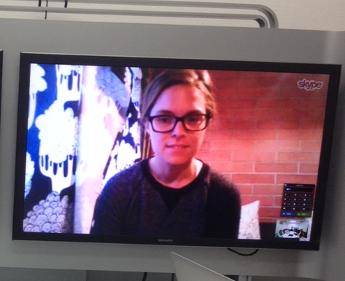
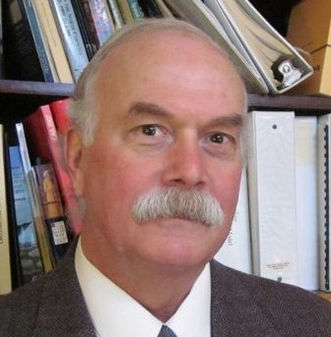
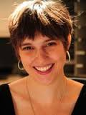

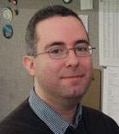
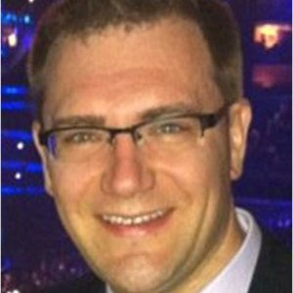

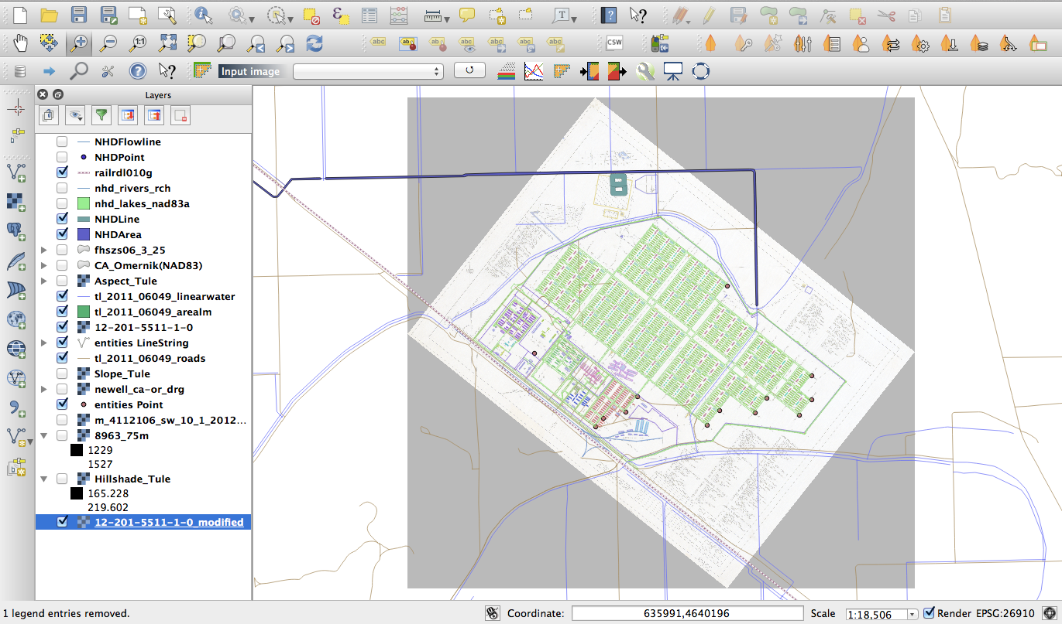

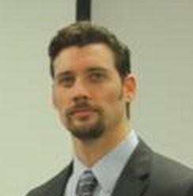
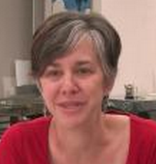
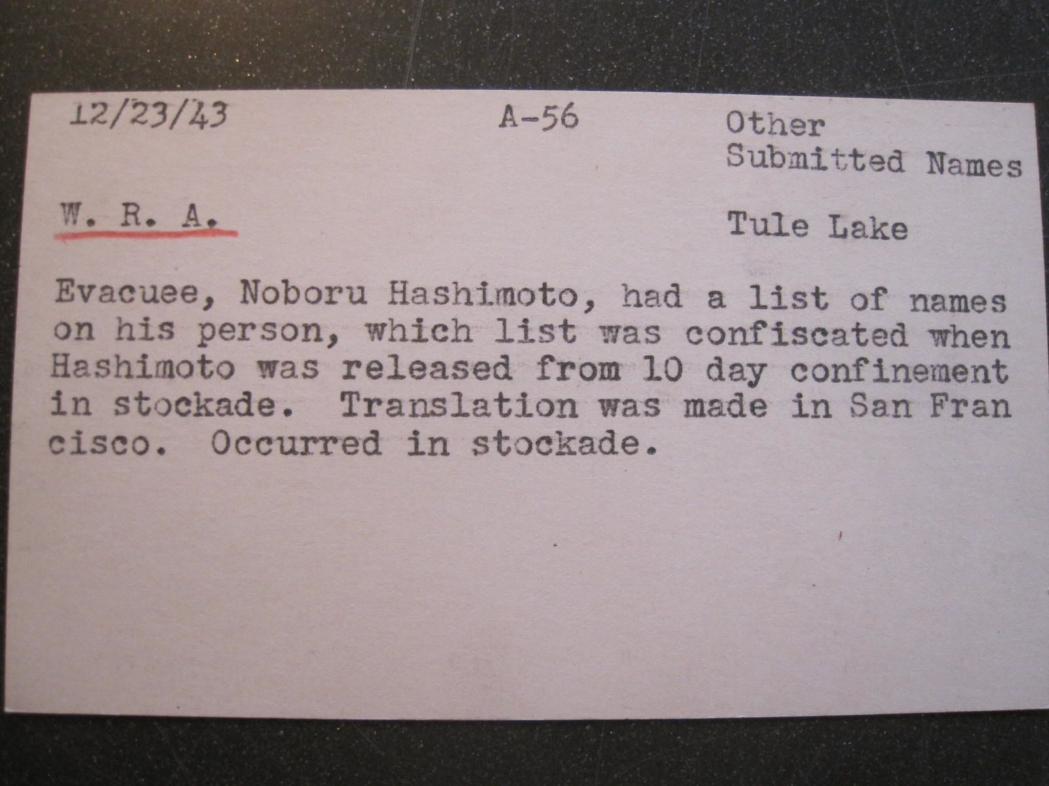
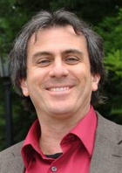
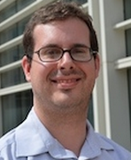




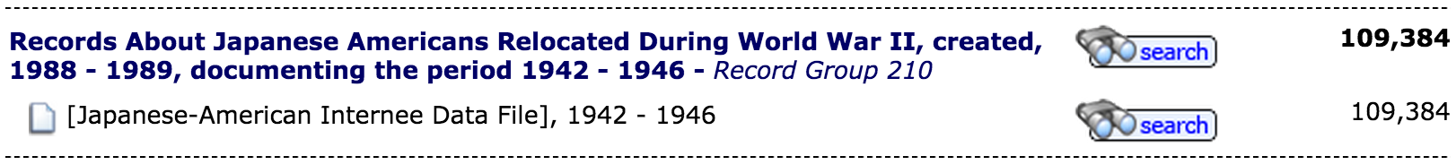



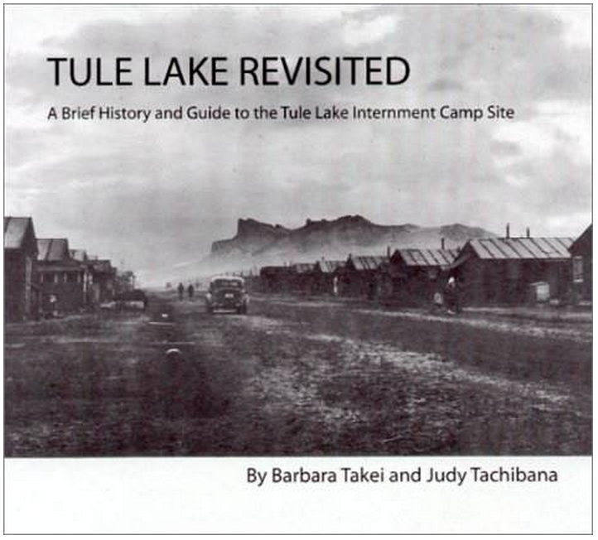

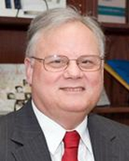
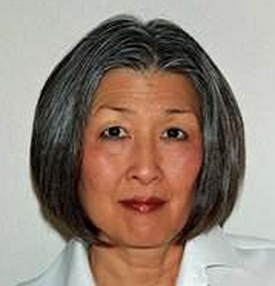



Informatics
International Inc.
Scott MADRY
UMD iSchool
Katie SHILTON
National Archives
John MARTINEZ
Markus MOST
Martha MURPHY
Chris NAYLOR
Nat. Park Service
Larisa PROULX
Jessica MIDDLETON
Don KODAK
John TOBIASON
INST641: Policy Issues
In Digital Curation
King’s College London
Mark HEDGES
Tobias BLANKE
UMD iSchool
Richard MARCIANO
UMD Journalism
Nick DIAKOPOULOS
Feb. 2, 2015
May 6, 2015
UMD iSchool DCIC Center
Greg JANSEN
Michael KURTZ
USHMM
Michael LEVY
Michael HALEY GOLDMAN
Filmmaker, Professor Emeritus,
Cal. State Sacramento
Satsuki INA
Tule Lake Committee
Barbara TAKEI
Notes:
Timeline and partners; a short summary of the process to accomplish the work (including how worked with your FIA Partner); Basically underscore that this project engaged a couple dozen people, from a large array of organizations and perspectives.
U.S. National Park Service
Harper’s Ferry
Don Kodak
John Tobiason
Tule Lake Unit World War II Valor in the Pacific National Monument
Larisa Proulx
Jessica Middleton
National Archives & Records Admin.
Office of Innovation
John Martinez
Markus Most

Slide 3
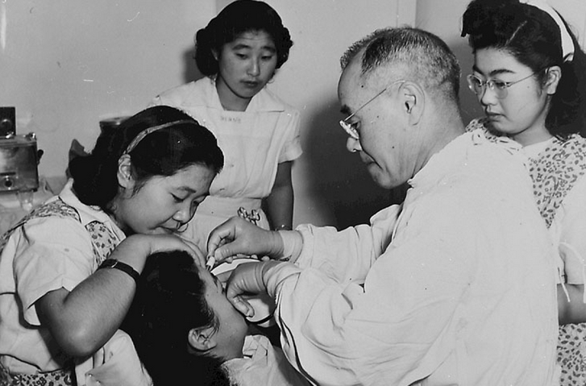
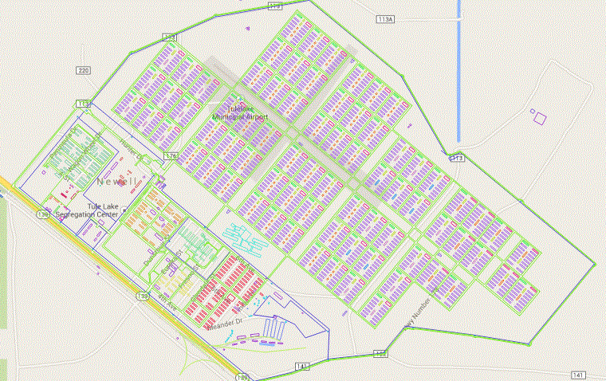
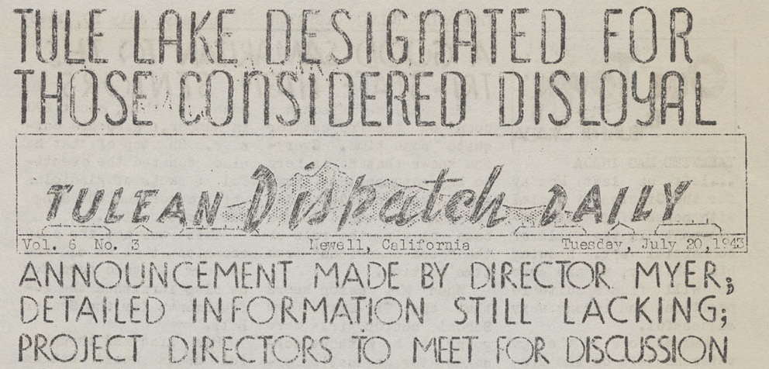

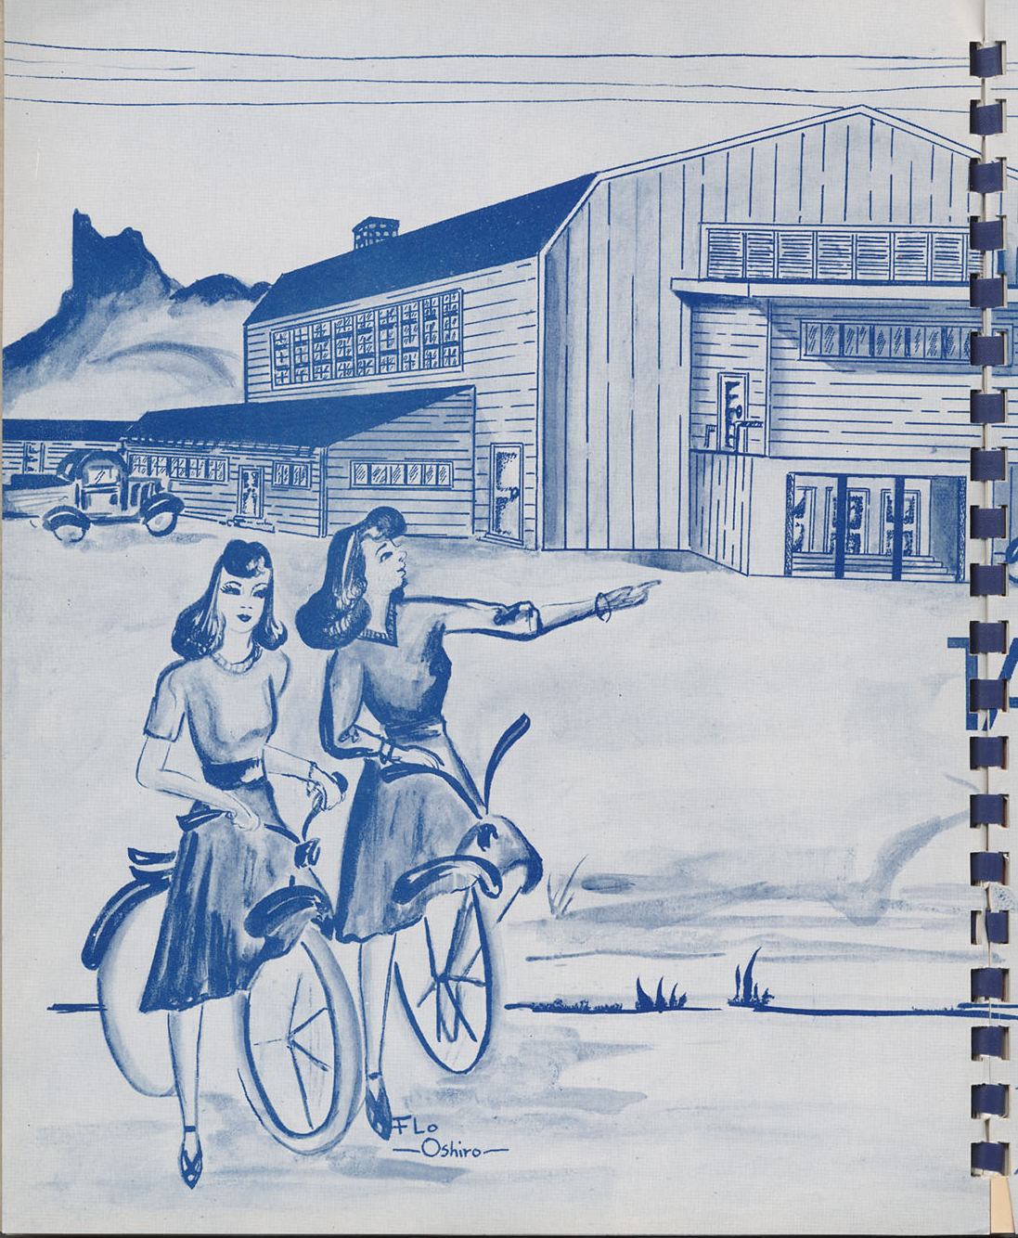


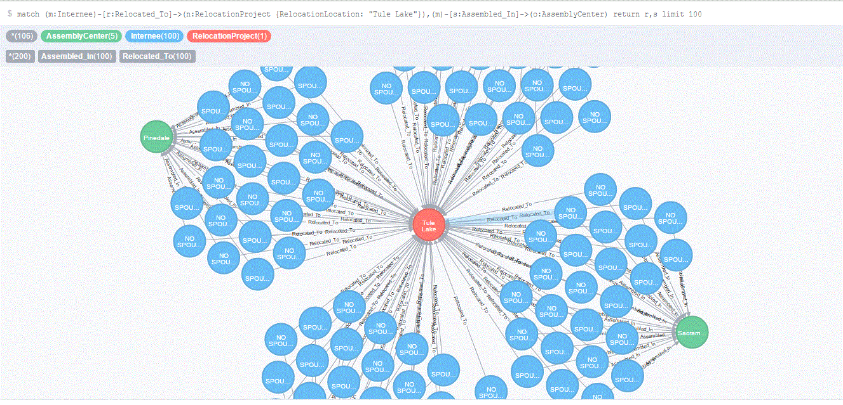
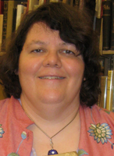
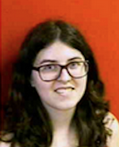
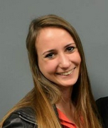
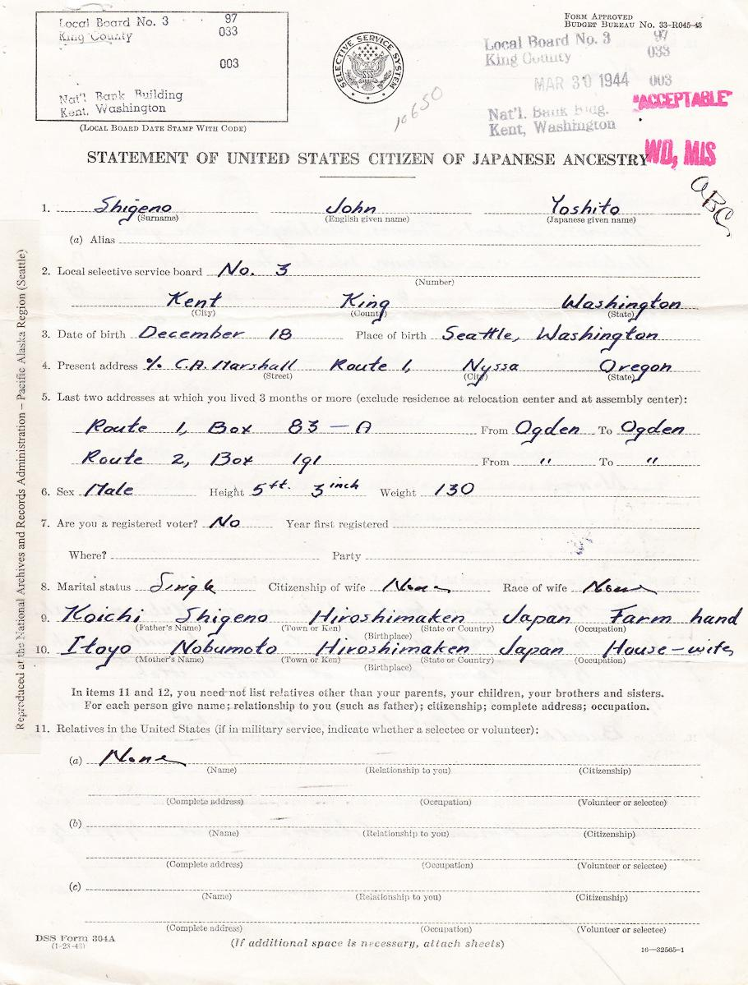
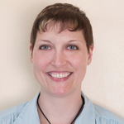
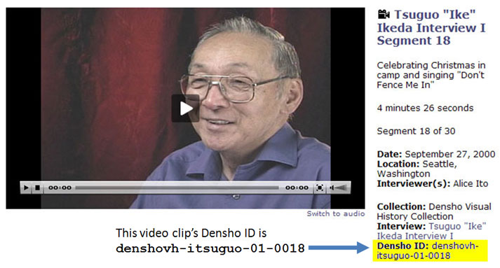
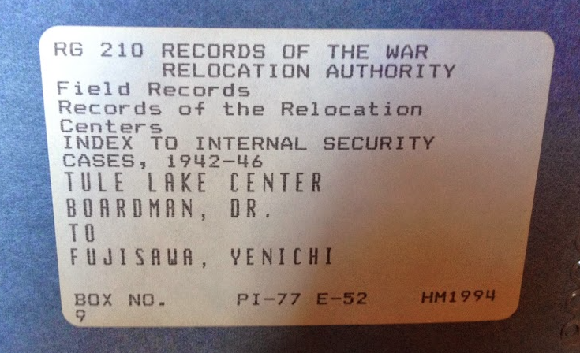
Drew BARKER
MLS student
maps
Liz TOBEY
MLS student
newsletters &
yearbooks
James HOWLAND
MLS student
photos
Dilip BHARADWAJ
PhD student
graph archives
Emily KEITHLEY
MLS student
oral histories
Karen MAWDSLEY
Journalism undergrad student
incident cards
Diane TRAVIS
Staff/PhD student
public records
Notes:
overview of role of 7 students: 5 (FIA Seed Grant students) + 2 (doctoral and MIM Capstone)

Slide 4
Drew BARKER
Maps & Stories
QGIS labels:
Wards, Blocks,
& Barracks.
~18,700 inmates
Provides a unique data set
for visual layers.

Slide 5
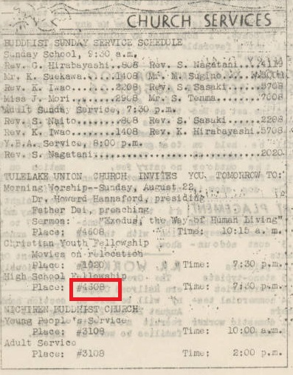
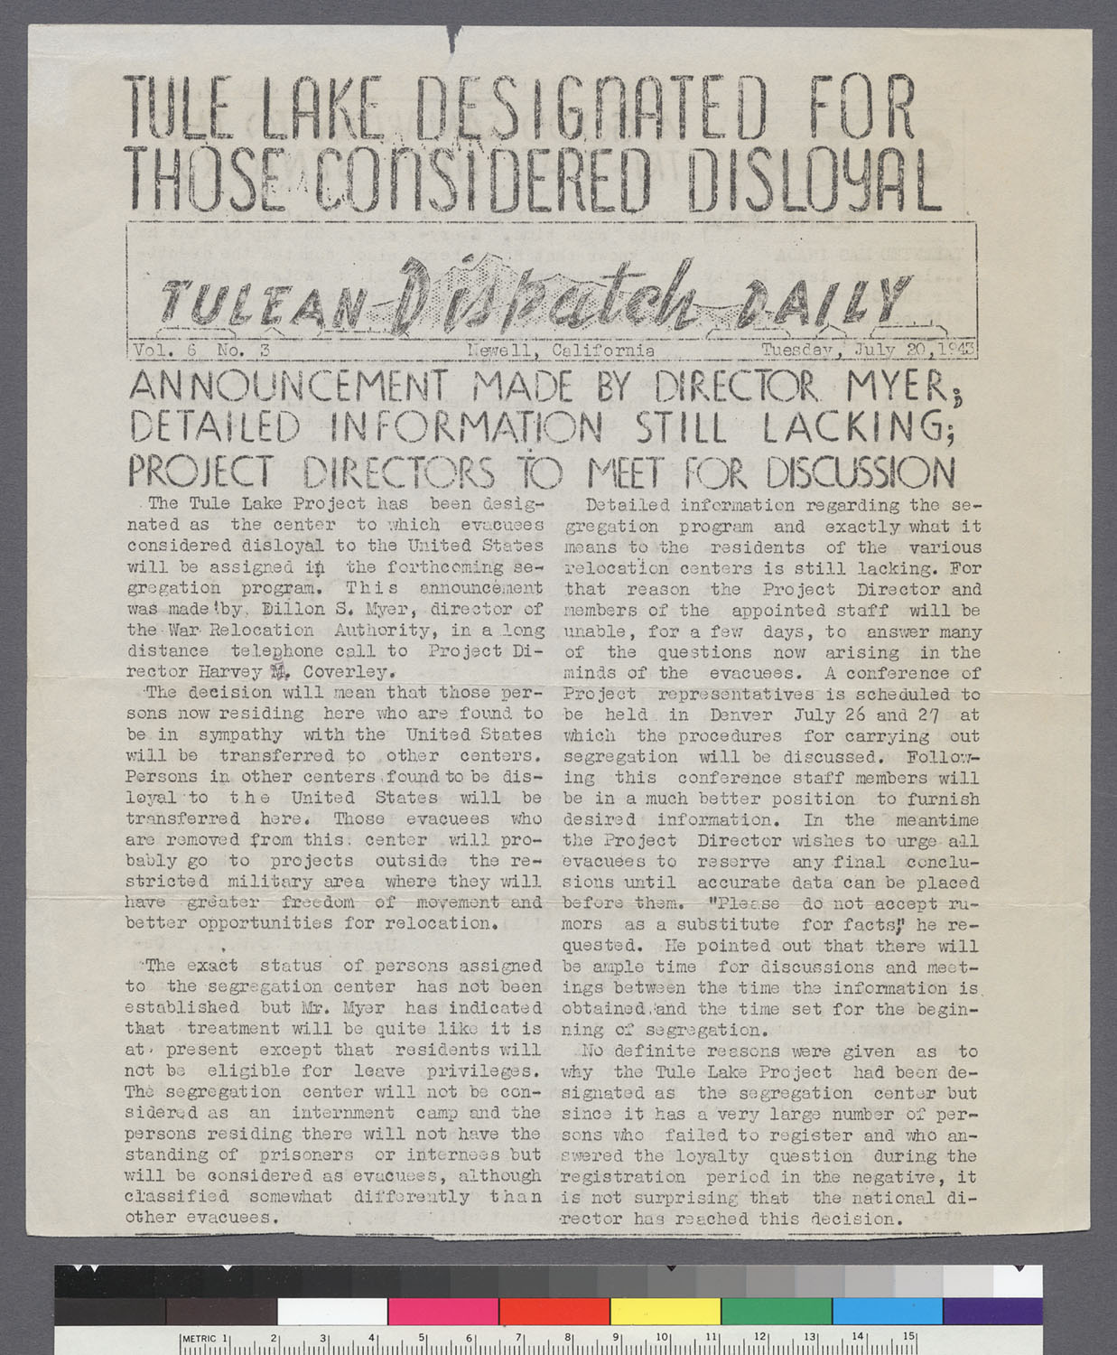
Liz TOBEY
Newsletters & yearbooks:
Left: Detail of Church Services, Tulean Dispatch Daily, 8/21/1943, p. 2, detail of block #4608
Right: “Tule Lake Designated for Those Considered Disloyal,” Tulean Dispatch Daily
7/20/1943, p. 1
Notes:
Many issues of the camp newsletter, the Daily Tulean Dispatch, along with the Tule Lake High School yearbook, the Aquila, are digitized on the Online Archive of California and the website of the Densho Foundation. I gathered metadata and links to individual issues of the newsletter at the collection, issue, page, and article level. Many of the articles reference specific block numbers that can be located on the camp map (block 4608 location of church high school fellowship meeting), names, and areas of the camp (building of jail).

Slide 6
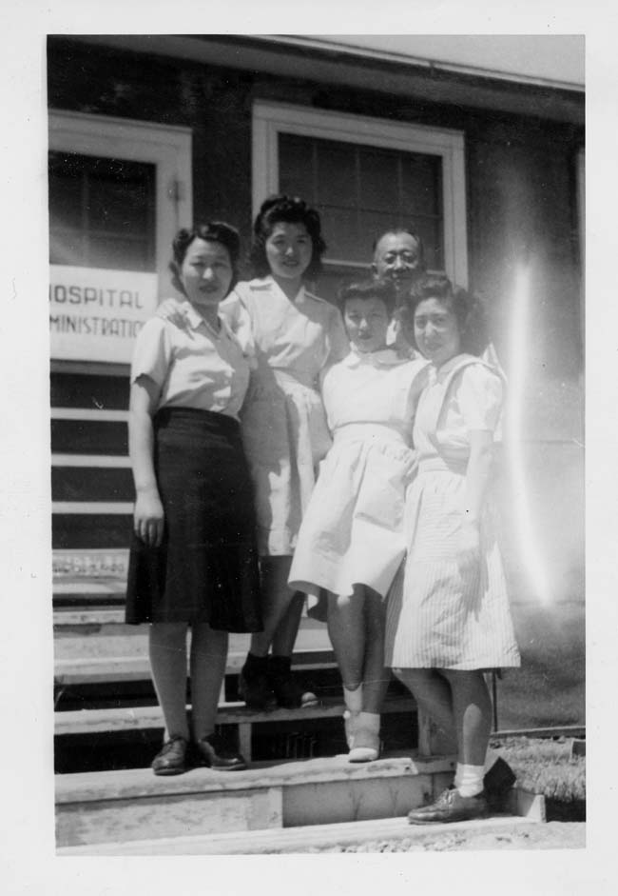
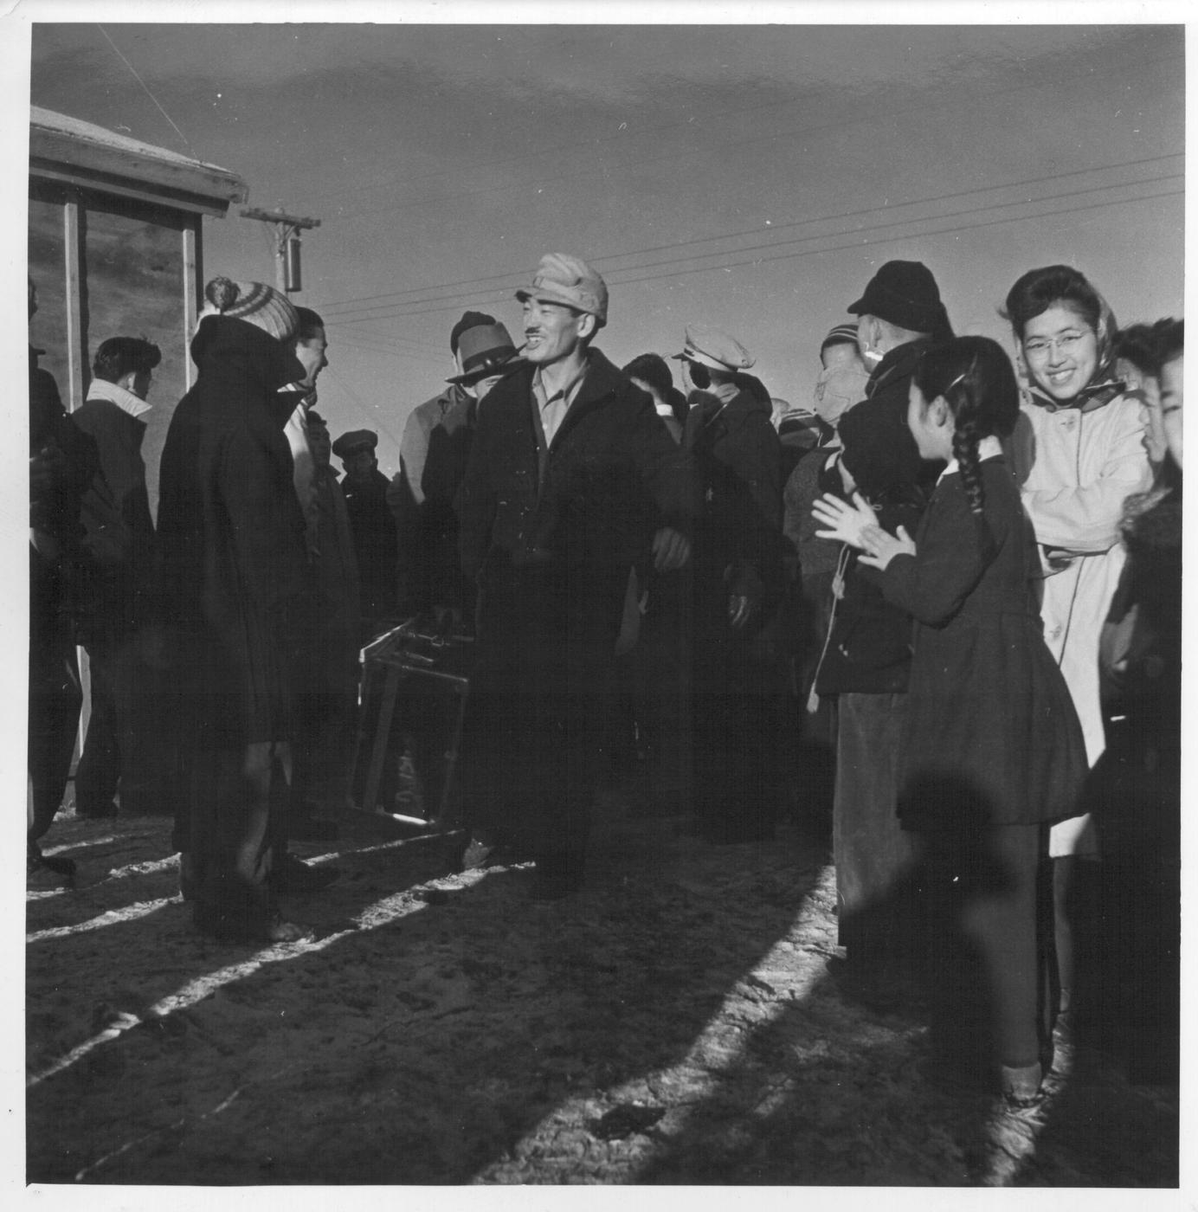
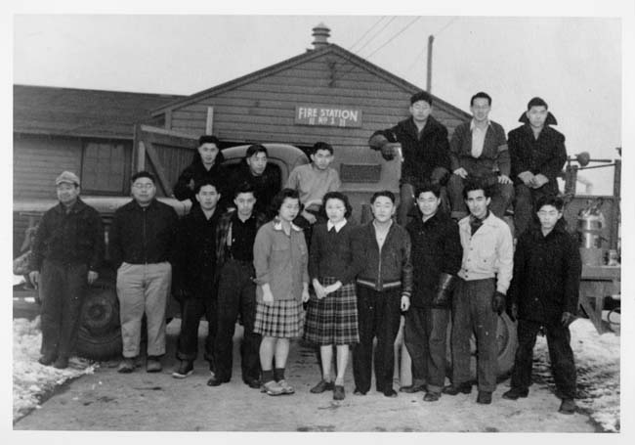
James HOWLAND
Photos of Life and Events in the Camp
Left: Photo of Dr. Taro and Aids at the Camp Hospital
Far Right: Photo of new arrivals from Manzanar entering Tule Lake
Right: Group photo at
Fire Station One
Notes:
Using JARDA’s Photo Collection I looked for photos that captured either people who did important work such the people who worked at the hospital, Volunteer groups like the one that worked at Fire Station 1, and important events like camp arrivals. During the project found it interesting that people often labeled locations in a personal vernacular rather than use the map labels. I think this illustrates how people subconsciously expect people to know what they are referring to.

Slide 7

Emily KEITHLEY
Oral Histories
Recollections of the past
Eyewitness interviews
Video, audio & transcripts
Notes:
Using the Densho Digital Archive’s website, we located oral histories discussing Tule Lake and linked them on the resource map. Seeing and hearing survivors’ accounts adds a very relatable, human element to this project.

Slide 8
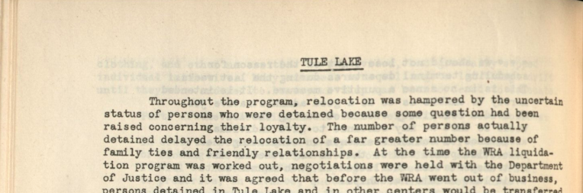
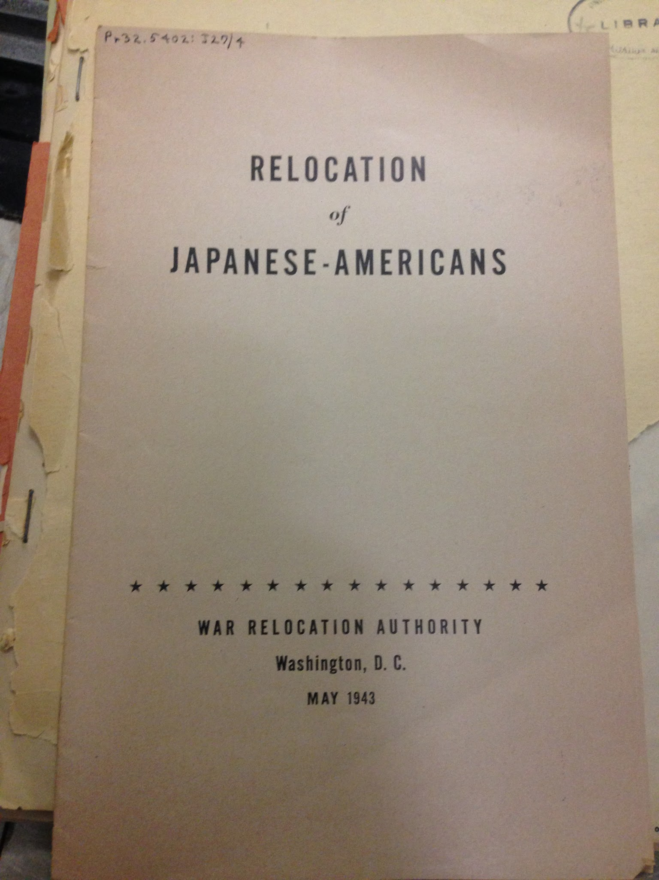
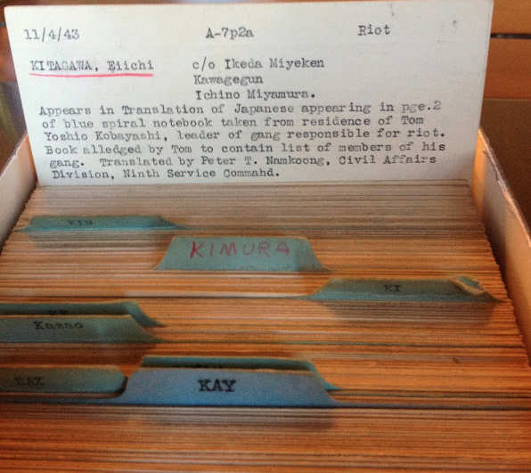
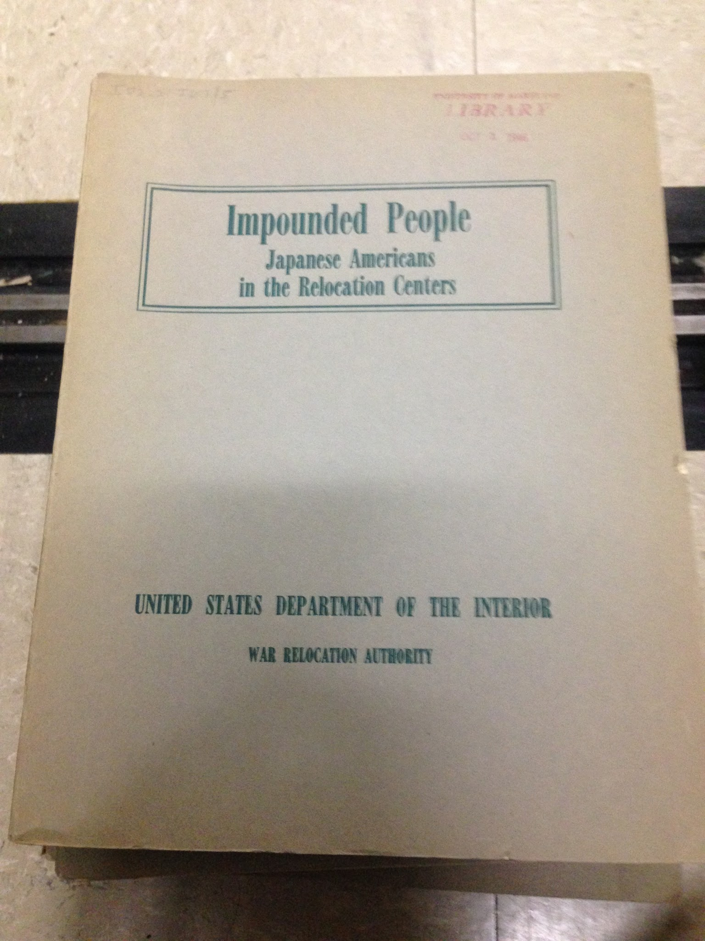
Karen MAWDSLEY
Incident cards from WRA, Record Group 210
Government documents
Notes:
I looked through photos Richard took of the incident cards. I also utilized the university’s government documents section of McKeldin Library to find resources pertaining to Tule Lake and Japanese internment overall.

Slide 9
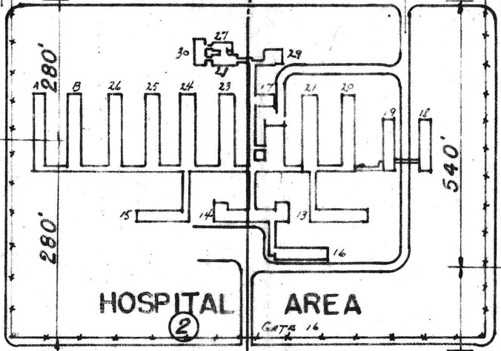

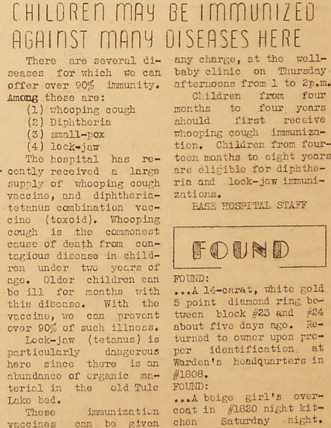
“Children May Be Immunized Against Many Diseases Here,” Tulean Dispatch 3 (52), Sept. 15, 1942, p. 3, Densho Foundation
Photo of Dr. Taro, Mrs. Akamatsu and aides on steps [Hospital Administration Building, Area 2, Bldg. 14], California State University, Sacramento Library
Notes:
Using QGIS software, we hoped to connect diverse digitized artifacts and events to precise locations on the map. This is just one example. Both the photo of Dr. Taro and his nursing staff in front of the hospital administration building, and this article on immunization from the Tulean Dispatch, refer to the Hospital Administration Building, Area 2, Bldg. 14.

Slide 10
Modeling with Archive Graphs (Dilip BHARADWAJ):
How is this graph unique?
Archive graph Graph database instead of relational database
More than 1 million records from NARA from all WRA and DOJ sites
in the form of nodes and relationships.
Accomplishments:
Family relationships: Created unique family nodes and developed relationships with the internees and inmates who shared the same family number.
Future recommendations:
Begin linking inmates to events documented on the incident cards.

Slide 11
Next Steps
Profs. Marciano & Diakopoulos submitted a 2015 JACS Grant: “Unlocking the Archives of the Tule Lake Segregation Center”:
JACS = Japanese American Confinement Sites Grant Program [NPS / U.S. Dept. of Interior]
Our category: preserving and interpreting U.S. Confinement Sites
If funded: $187K, 2-year project (Sep. 2015-Aug. 2017):
  Incident cards for Tule Lake will be integrated and expanded to other camps.
  Graph databases and GIS tools will be expanded.
  Interactions with stakeholders, scholars, and historians will be further developed.
Incident card from NARA
Notes:
what are your next steps to continue this work? discuss sustainability strategies.
Staffing details:
3 Master’s students at 10 hours / week each for 2 years
1 part-time Graduate Research Assistant for 2 years
1 Doctoral student (Diane Travis) to help guide the project
Faculty involvement:
Marciano (16% cost-shared + 1 summer month the 2nd year)
Diakopoulos (1 summer month 1st and 2nd year)

