Slide 1
Locating People in the Past:
Creating New Geographic and Historic Knowledge by Embedding the United States Census within Historic Maps

Slide 2
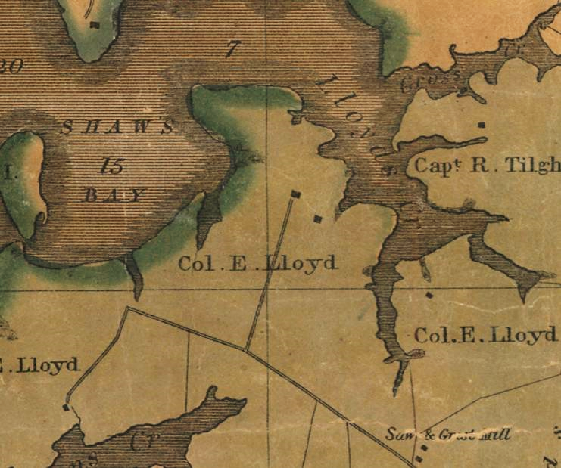

Slide 3
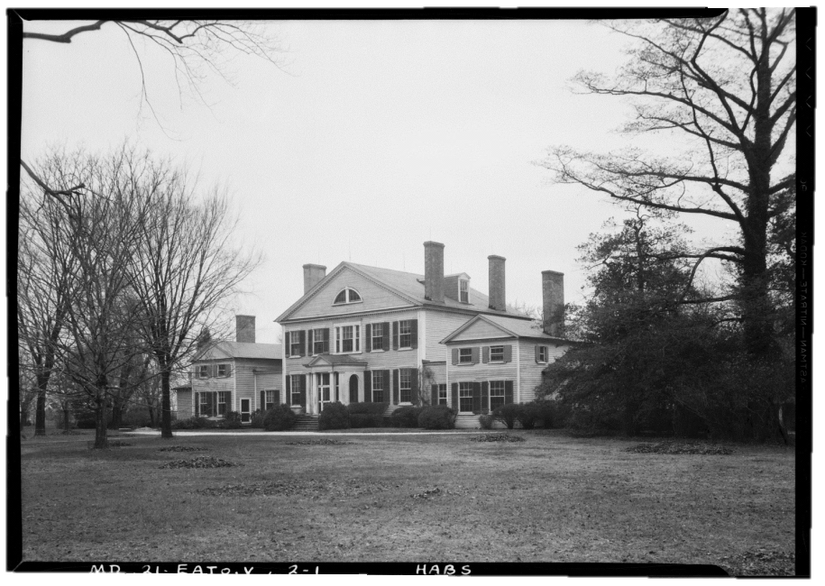
Wye House, Talbot County, Maryland. Built c. 1781-1784.
Historic American Buildings Survey, 1936

Slide 4
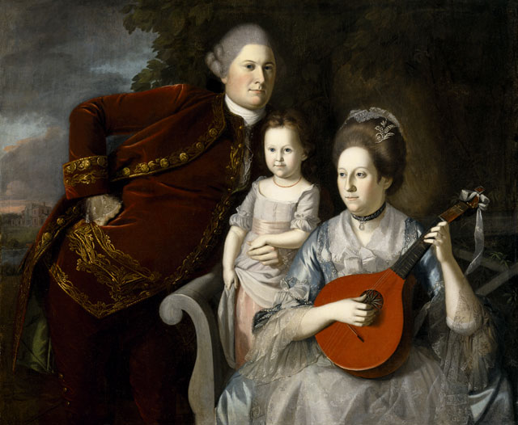
The Edward Lloyd Family. Oil on canvas portrait. Charles Willson Peale. 1771.
(Left to Right) Edward Lloyd IV, Ann Lloyd, Elizabeth Tayloe Lloyd.

Slide 5
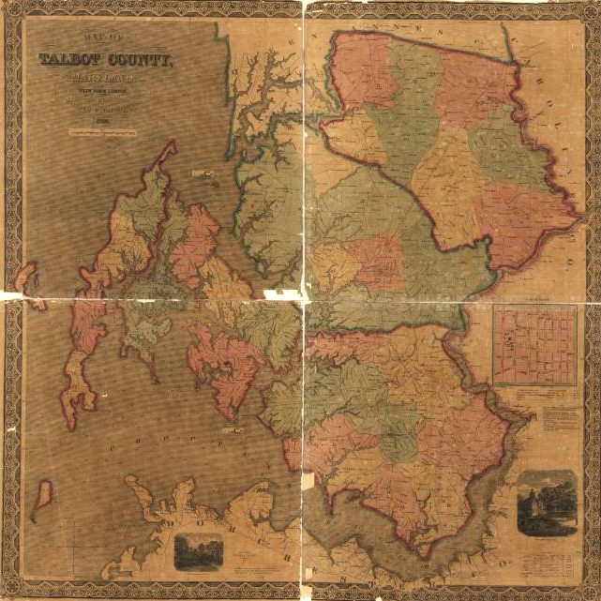
William H. Dilworth Map of Talbot County, Maryland. 1858

Slide 6
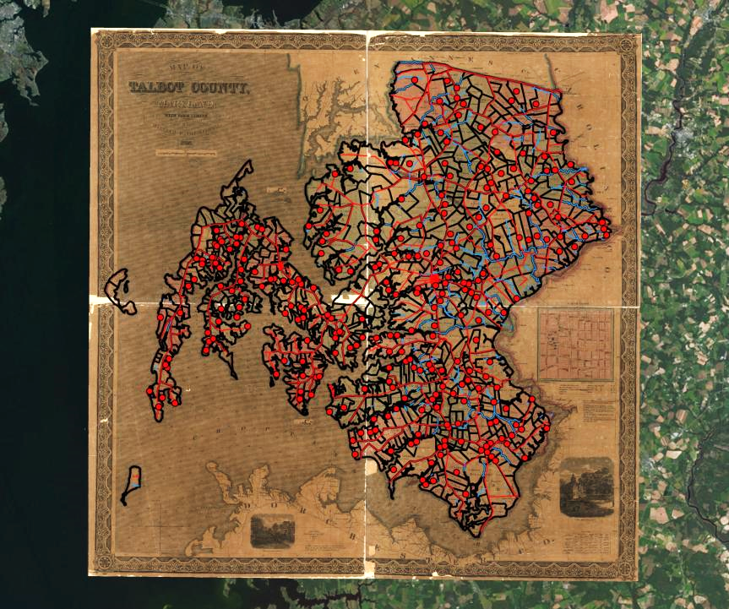
Digitized and Georeferenced Dilworth Map

Slide 7
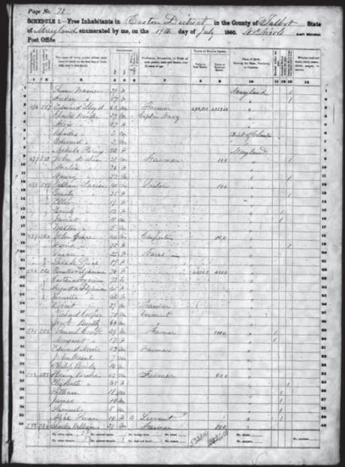
United States Census. Talbot County, Maryland. 1860.

Slide 8
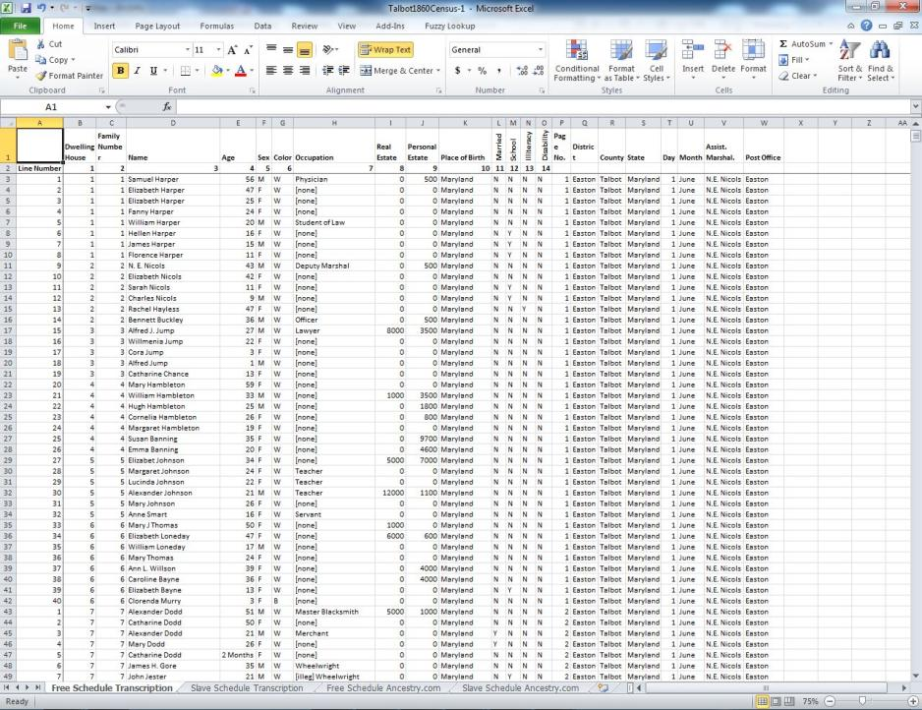

Slide 10
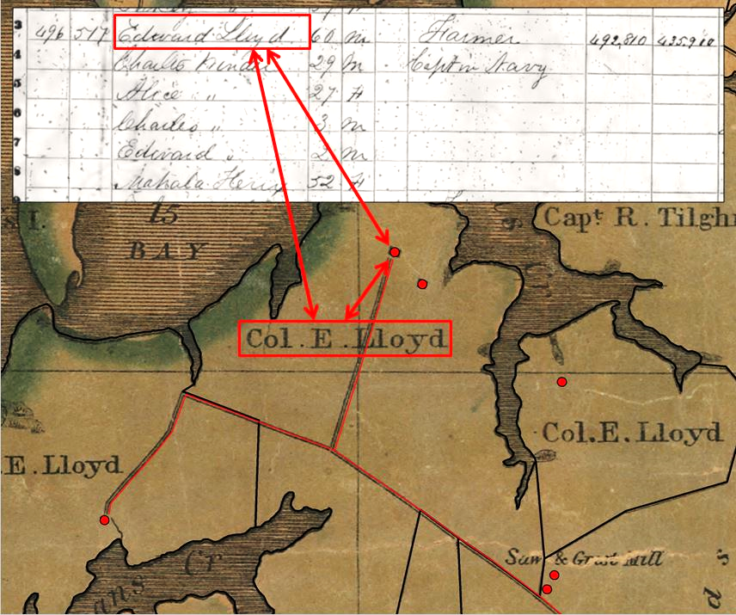

Slide 11
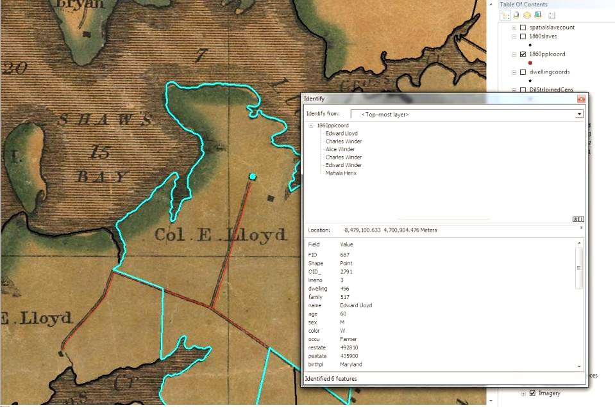

Slide 12
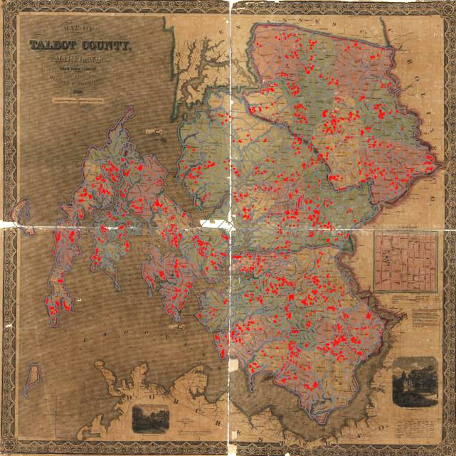

Slide 13
United States Census. Talbot County, Maryland. 1860.

Slide 14
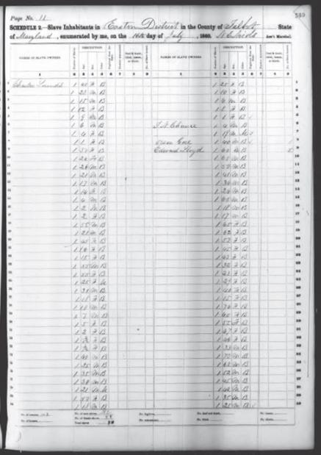
Free Schedule
Slave Schedule
United States Census. Talbot County, Maryland. 1860.

Slide 15
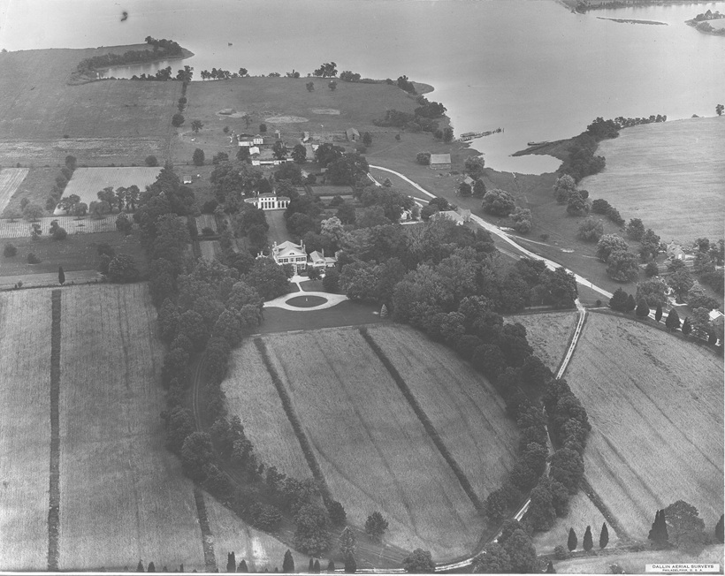
Wye House, Talbot County, Maryland. Built c. 1781-1784.
Dallin Aerial Survey, c. 1920-1930

Slide 16
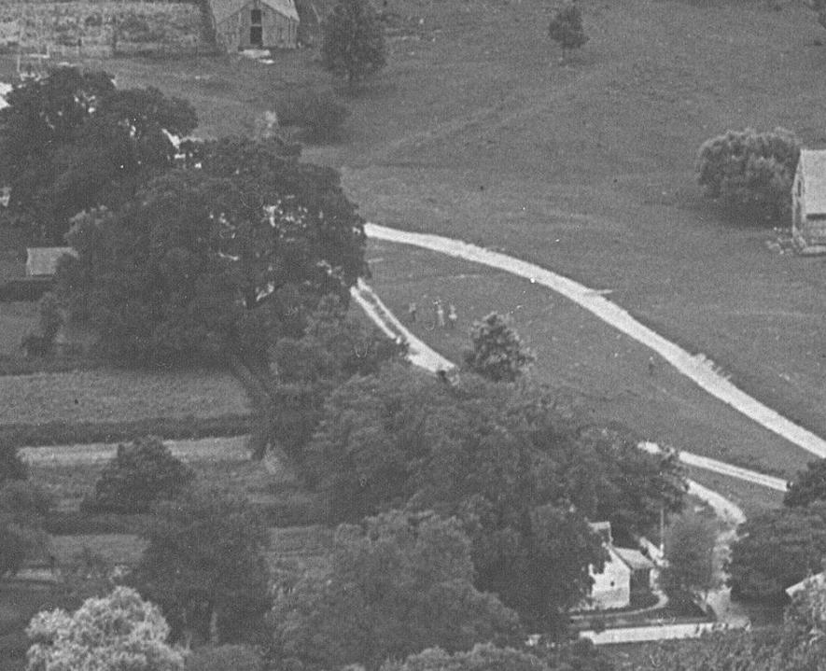

Slide 17
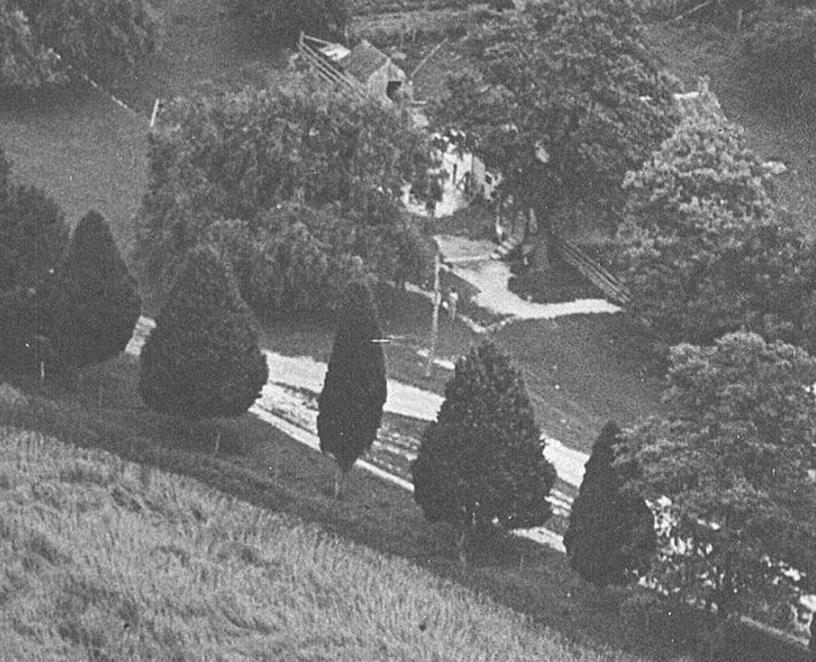

Slide 18
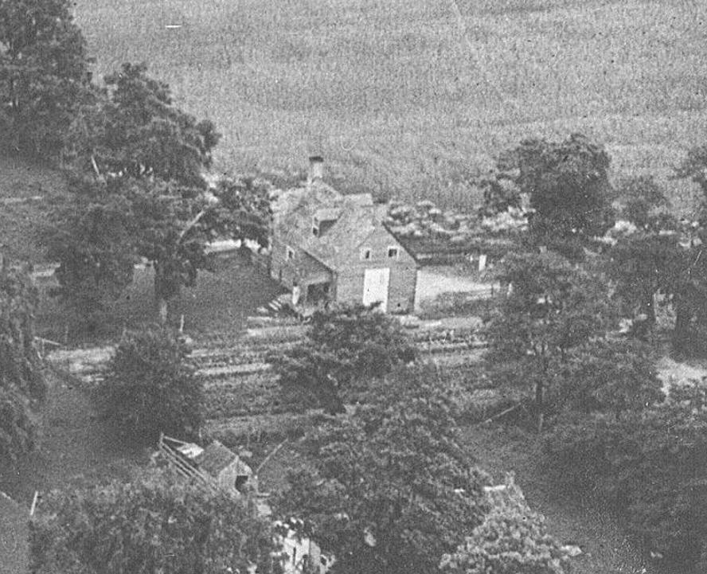

Slide 20
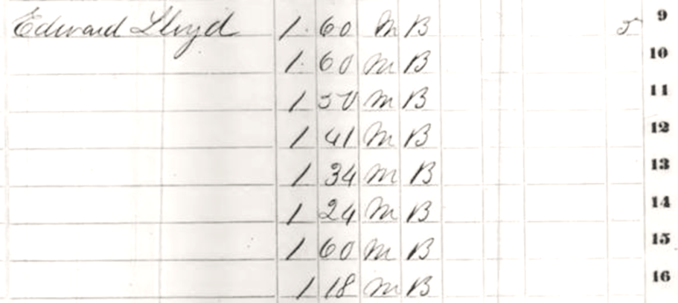

Slide 21
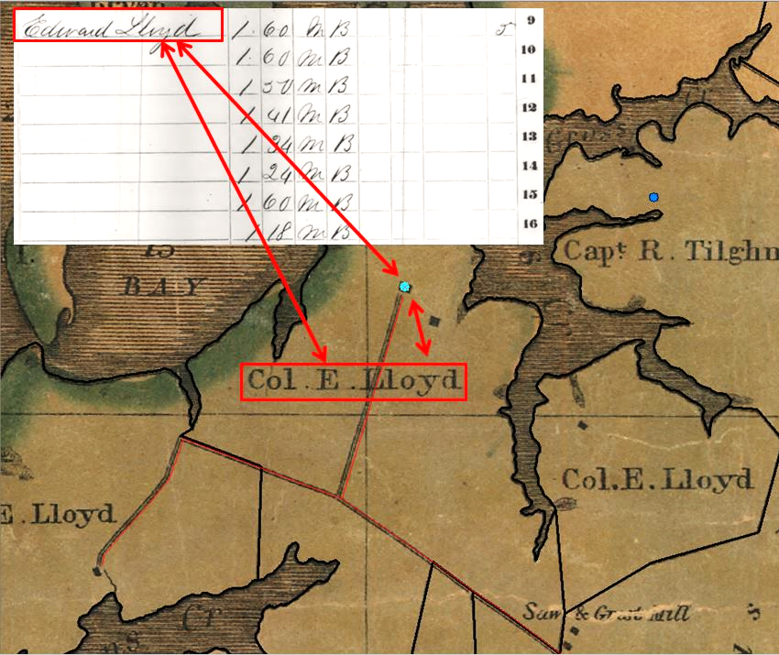

Slide 22
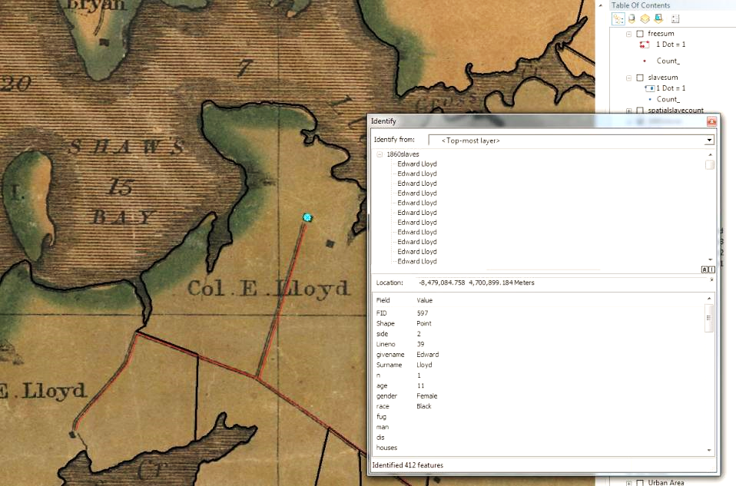

Slide 23
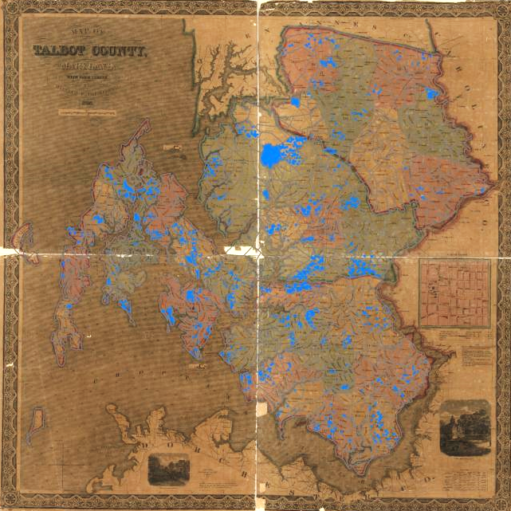

Slide 24
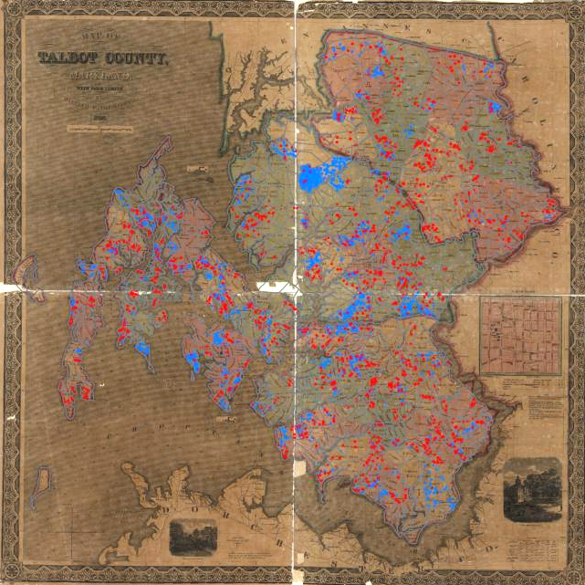

Slide 25
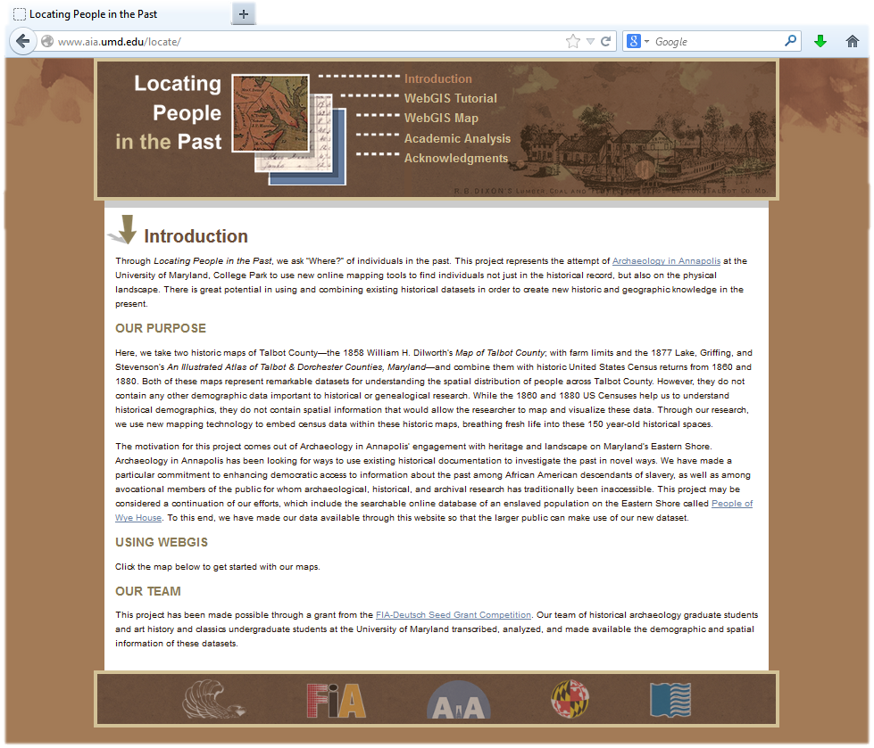
www.aia.umd.edu/locate

Slide 26
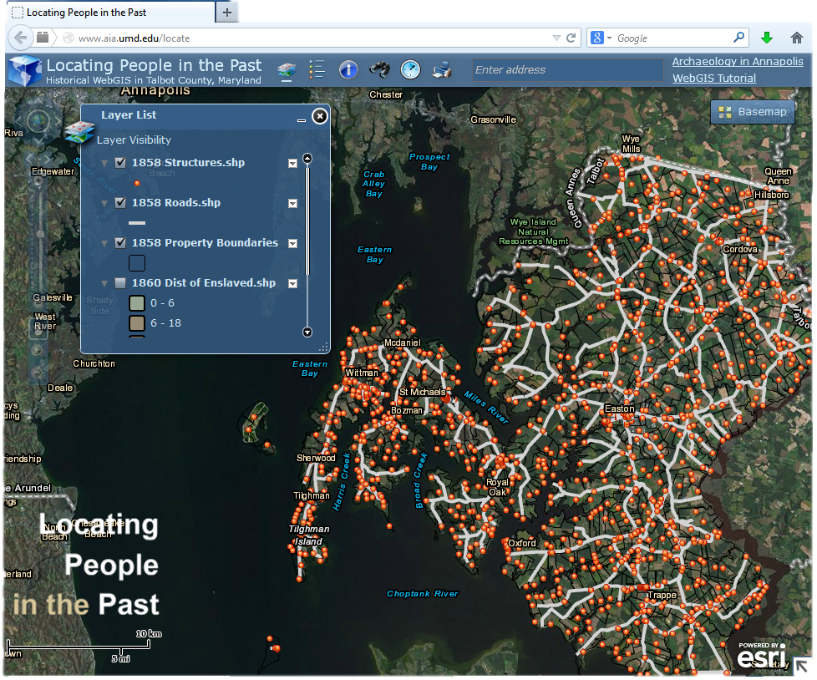
www.aia.umd.edu/locate

Slide 27
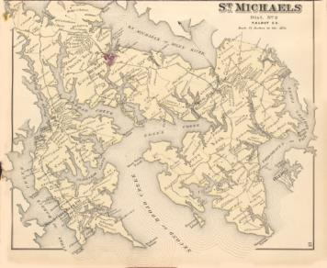
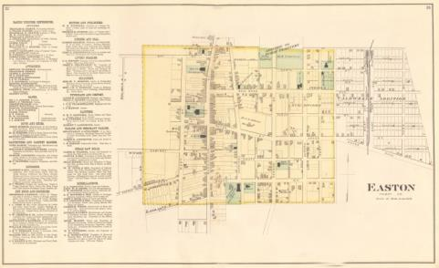
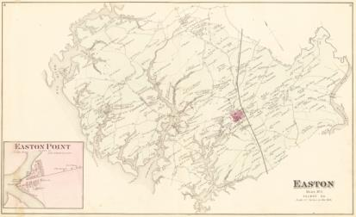
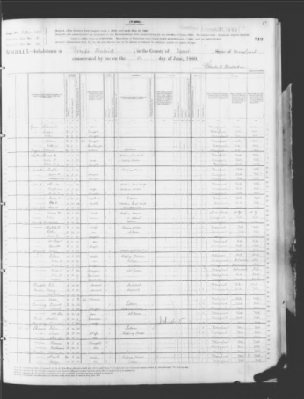
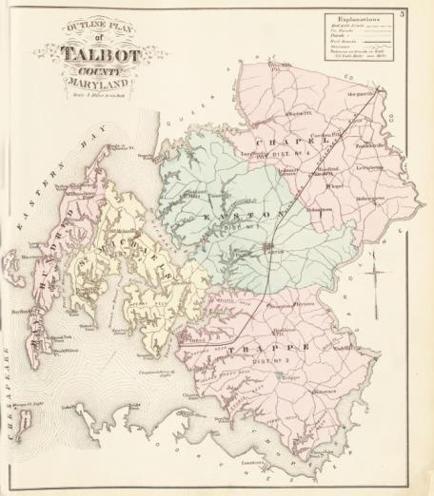
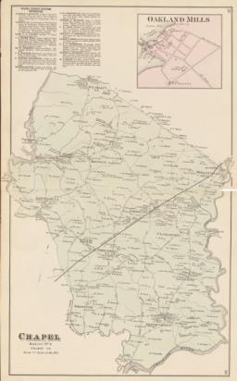
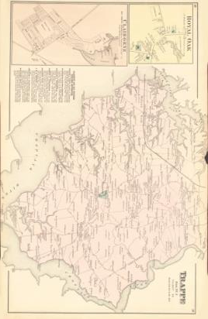
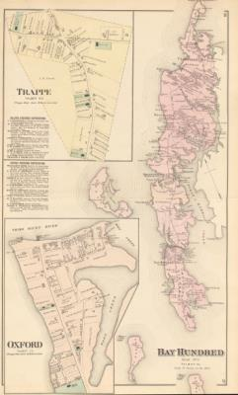
1877 Atlas and 1880 Census

Slide 28
Acknowledgements
For all of their help, both past and future,
we would like to thank:
The Future of Information Alliance
The Robert W. Deutsch Foundation
The FIA-Deutsch Seed Grant Competition
The Library of Congress
The National Archives
Frederick Douglass Honor Society
Beverly and Richard Tilghman
All Descendants of Wye House and Talbot County
Team Members
Clio Grillakis
Beth Pruitt
Benjamin Skolnik
Marcella Stranieri
Stefan Woehlke
Kathryn Deeley
Dr. Mark Leone
www.aia.umd.edu/locate

