Slide 1
Empower Ecuador
Jessica Belt, Stephanie Ingber, Lorena Kowalewski, Julia Nagy, Ian Reichardt
Mentors: John Lea-Cox and Bruk Belayneh
Notes:
-mention the value of being interdisciplinary- A conflict this multi-faceted does not have one solution. We were able to be objective and knowledgeable in different areas. need to provide information from our different backgrounds to tackle the conflict from different perspectives, able to study diff aspects of the issue.
-cutting edge technologies vs. agrarian society
-what is our unique contribution?- inter disciplinary approach?
-we leveraged funds from “x”- rachel, personal funds, USDA, etc. mention that FIA was only able to support some of the travel costs
-all students can talk in presentation- just make sure it is coherent
-key talking points
a. why this research needs to be tackled (tied to FIA priorities); guided our process.
Infoequity:
Infoliteracy: the farmers need access to information regarding water availability and its variability within the watershed
Transparency: make it easy for farmers to access information by creating
Infotransfer: in places with minimal resources/ access to information, we can attempt to provide farmers in rural areas with an opportunity to educate themselves about their constitutional rights.
collaboration: strength in numbers, the more people with a voice, the louder you can be heard. grassroots idea? start small to have a large impact
b. a short summary of the process you took to accomplish your work (including how you worked with your FIA partner);
segway from collaboration priority
FIA money
interdisciplinary
what we found- tell a joint story
c. your outcomes to-date; what impact this will have on the future of information
sustainability plan for the project
show the power of the team
“outcomes to-date; what impact this will have on the future of information”
;conceptual piece- what’s interesting and replicable?
methods
why research needs to be tackled- tie to FIA priorities
process of our work
socio-environmental impact- spoke with farmers and got input that can not be found in a book or online. able to put together a survey that will incorporate ALL information necessary to provide credible evidence?
differentials in culture/rights/etc.
d. what are your next steps to continue this work?
What is the value delivered?
what did we take away from the project? Appreciation of the resources we have in terms of information access?

Slide 2
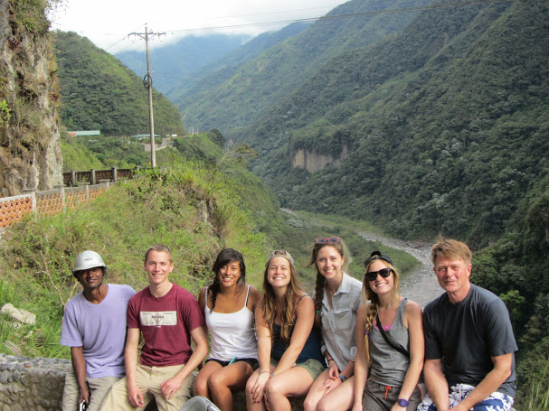
College of Behavioral and Social Sciences
College of Arts and Humanities
Clark School of Engineering, Civil Department
College of Agriculture and Natural Resources
Notes:
change white font

Slide 3
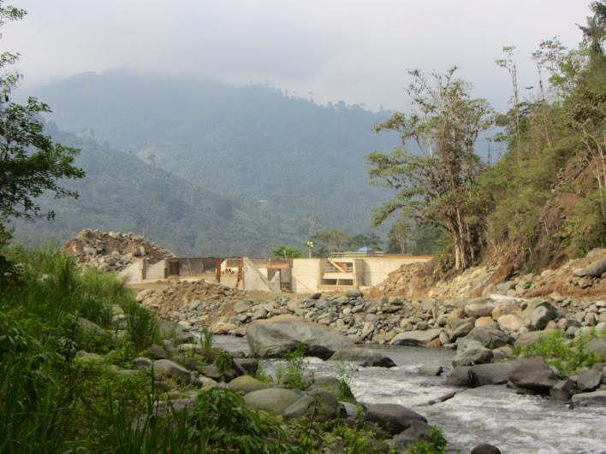
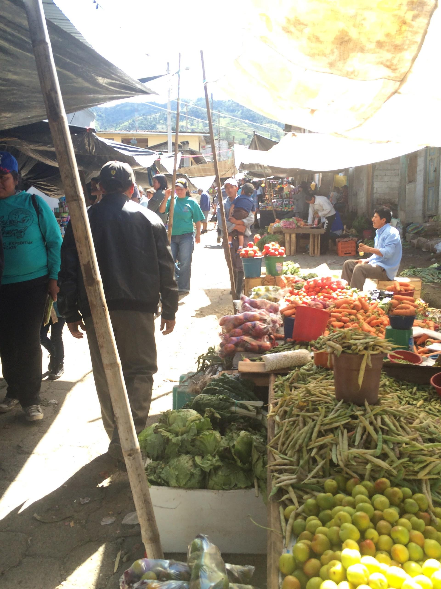
Background
Notes:
Our project focuses on assessing the water needs of the Dulcepamba watershed within the Bolivar province of Ecuador.
The construction of a hydroelectric dam at the base of this agriculturally productive region is threatening the community’s access to water for irrigation.
The government granted the hydroelectric company a concession for up to 90% of the water in the region. Meaning farmers will not be able to use that water for their crops.
Our project focuses on quantifying the availability of water in order to determine the social and economic impacts of the dam.

Slide 4
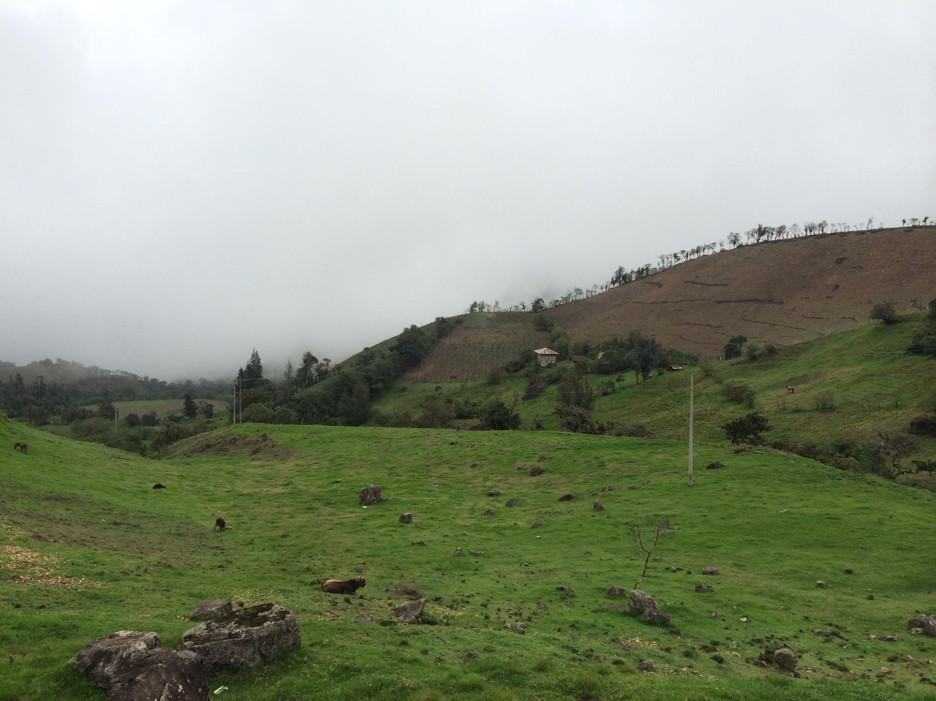
FIA Priorities
Info equity
Info transfer
Info literacy
Collaboration
Notes:
Infoequity: The farmers in the watershed do not have access to modern techniques and technology that can be
used to evaluate their water needs. We will use these tools (weather stations and crop
models) to collect, analyze, and distribute information to the community, that will improve their
understanding of how much water their crops use, and hence their irrigation water needs. By providing
the community with this new source of digital information, we hope to reduce the digital divide, and
thus improve their infoequity.
Infoliteracy: infoliteracy is important for the members of this community, because they
need access to information regarding water availability and its variability within the watershed, on both
a short- and long-term basis. This is a critical need, so that everyone can understand water supply and
demand, and how specific actions impact the utilization of these water resources
Infotransfer: An important aspect of this outcome is the translation of raw data
collected by the team into a more usable form, with increased accessibility through a simple website
interface. Through a dialogue with the community members in the
watershed, we will implement the best strategy for their needs. We believe that this will allow for
greater infotransfer of valuable information to the communities of the Dulcepamba watershed
collaboration:Our cross-disciplinary collaboration will make this research more effective and
enhance the positive outcomes for the community.

Slide 5
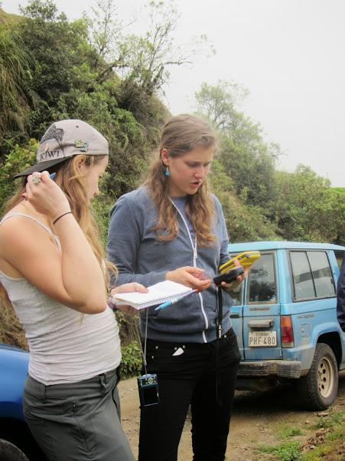
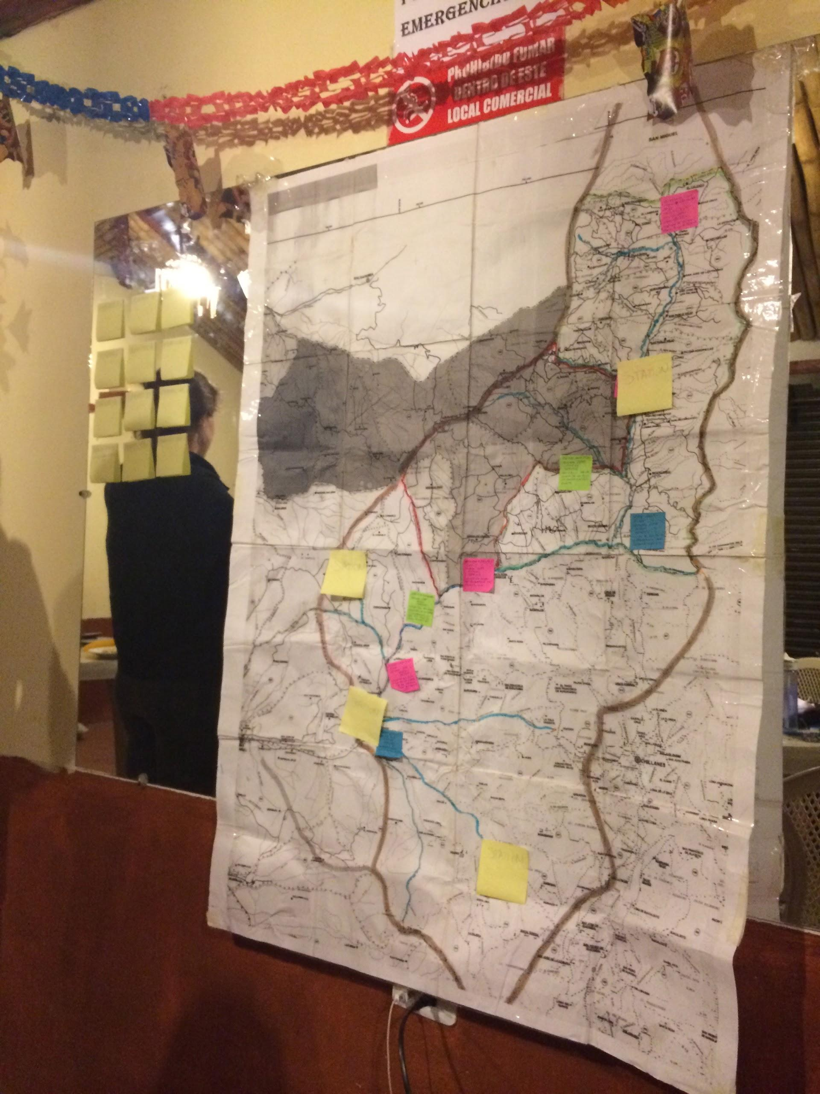
Process
Notes:
-went down to ecuador over winter term with the of FIA’s generous grant.
- establish/ connect/ set up weather stations
-GPS and mapping points
- set up and conduct meetings with local farmers in the watershed

Slide 6
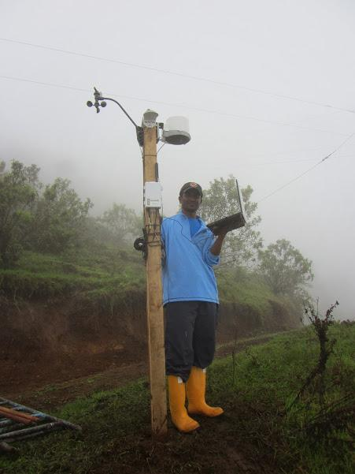
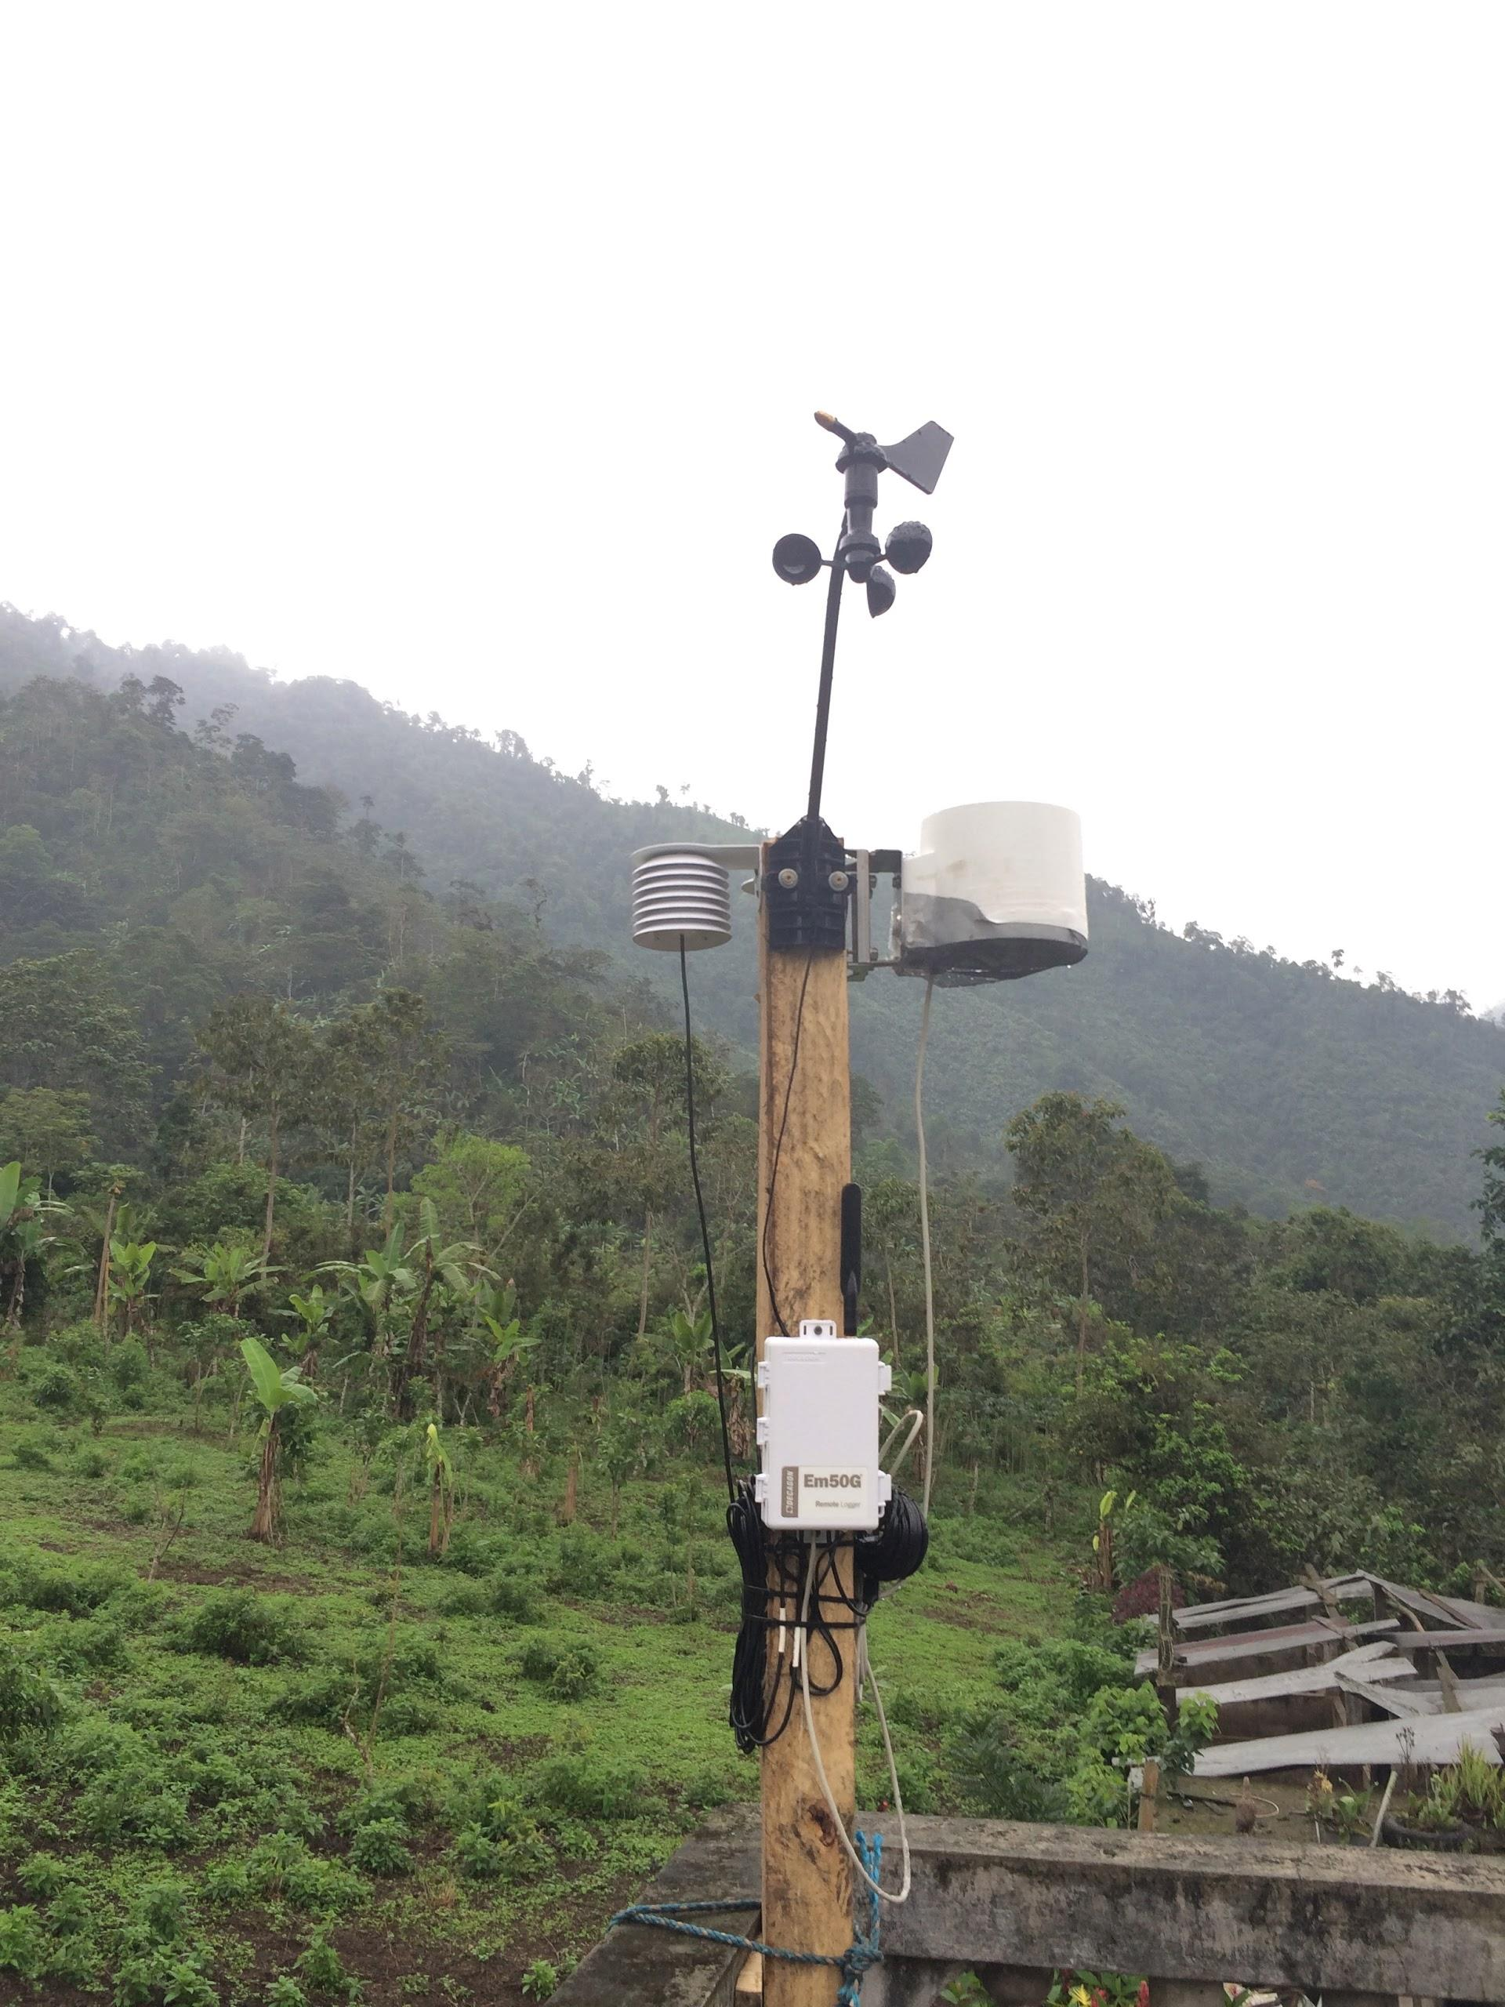
Weather Stations

Slide 7
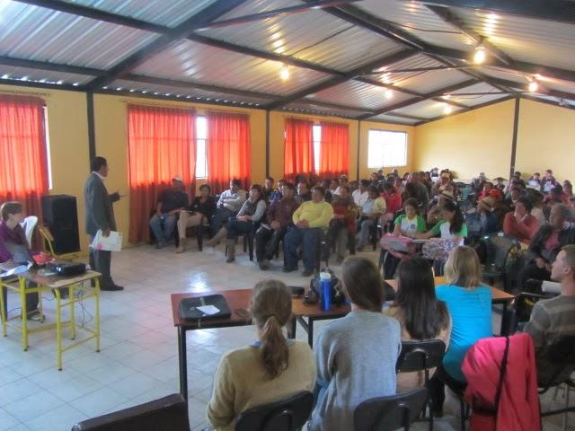
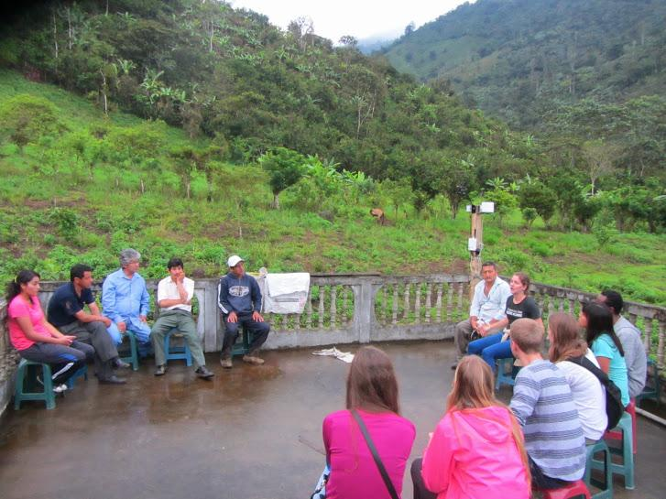
Community Engagement
Notes:
Winter
In December our team traveled to the Dulcepamba watershed in order to install 4 internet-enabled weather stations and foster community support and understanding of our project. During our time in Ecuador, we worked closely with Rachel Conrad, a fulbright scholar and her collaborator from the Ecuadorian NGO- Accion Ecologica, as well as members of the communities and their leaders.
The generous contribution from FIA was put toward the undergraduate’s airfare costs for travel to Ecuador.
(insert pictures here- a photo of weather station and a photo of the community members/ them filling out surveys)
Spring
This semester, we are taking part in a Capstone course in which we are continuing our work on the project.
Held a seminar in the PLSC building where we presented our project and were able to make connections with other contacts.
The weather stations provide us the data necessary for computing crop models in order to estimate irrigation needs in the watershed, specific to crop type.
We are in the process of creating a user-friendly website in order to disseminate the crop water use information so that farmers can irrigate wisely.
With a more detailed understanding of crop water use, we hope that the community will be able to collectively apply for irrigation water concessions.

Slide 8
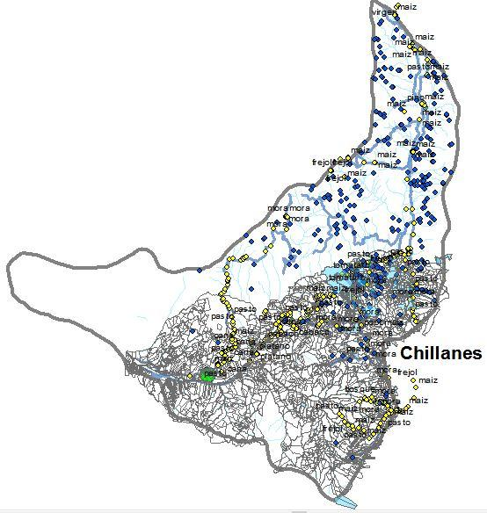
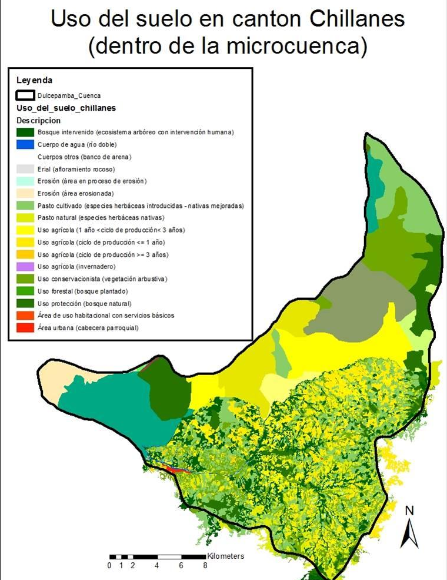
Crop Mapping
Notes:
The first map shows all of the GPS points of different crops in yellow as well as the properties with irrigation concessions shown in blue. we are using GPS poins of the crops along with aerial imagery to estimate the total acreage of each major crop in the watershed. The second map shows a detailed land use map, which can be used to find the acreage. The crop acreage will be used to scale up crop modeling water use to estimate the total water needed for crop irrigation in the watershed.

Slide 9
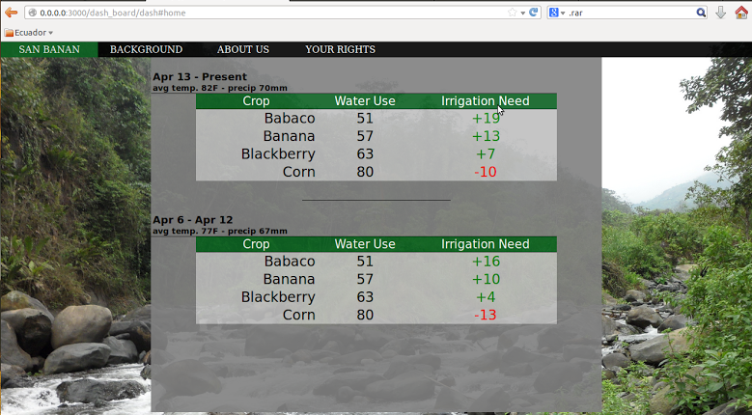
Notes:
Outcomes:
Weather Stations: still functional and transmitting data
Surveys: now have comprehensive surveys ready to be distributed. Include more thorough questions about crops and demographics that will provide extremely credible data. Gained extensive knowledge about how Ecuadorians who grow crops in this region conduct their businesses and/or go about their lifestyles. (picture?). with the information we gathered from meetings, can gain an average price of how much a crop goes for on the markey/ what units of measurement are used for crops and land.
Website: almost completed, will display crop water needs for each different weather station

Slide 10
Socio-economic Surveys
Notes:
-There are brand new surveys that we haved derive with the old information we gathered from communities while we were down in Ecuador. These surveys were designed to gather complete and credible data and ask questions are are ecuador farmer specific
-Living standard measurement survey as template to create new ones

Slide 11
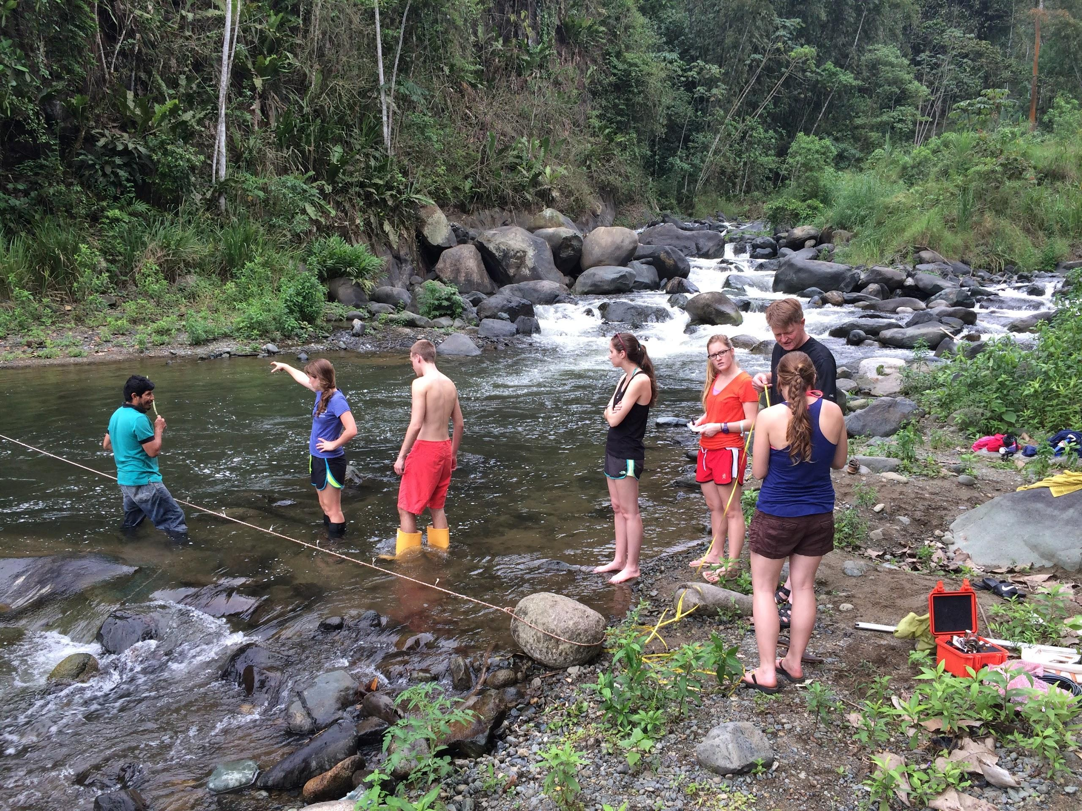
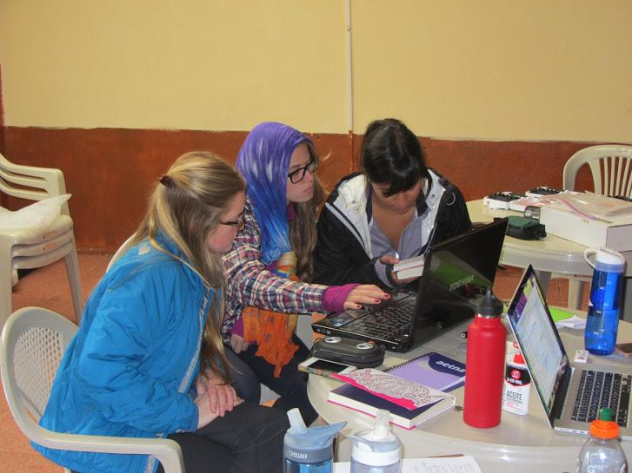
Collaboration
Notes:
-mention the value of being interdisciplinary- A conflict this multi-faceted does not have one solution. This issue had roots in economics, agriculture, policy, sociology, and technology. By bringing together our different areas of expertise, we were able to face this problem from many angles.
-collaboration
-we’ve all learned from eachother. none of us are experts. learning process. different persepctives .

Slide 12
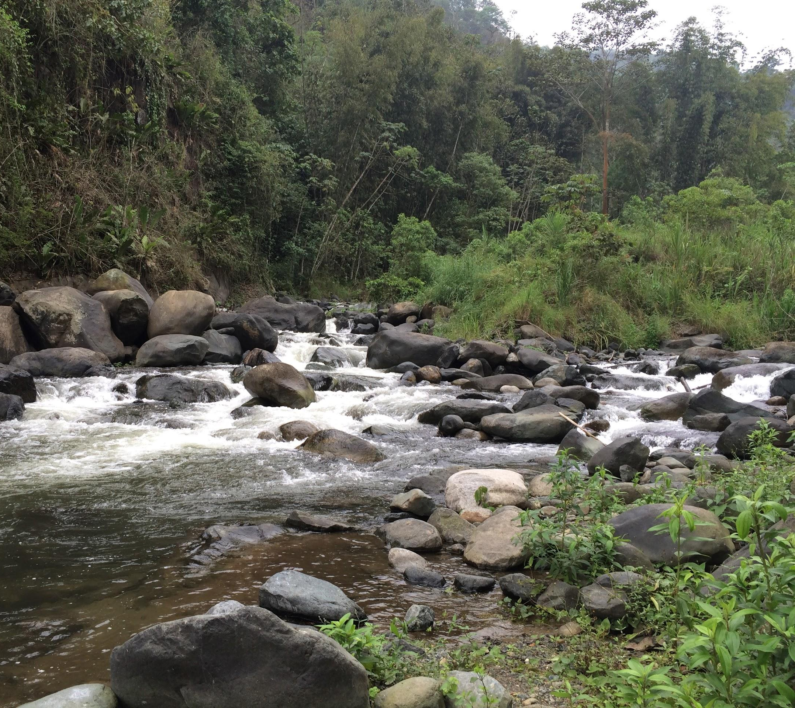
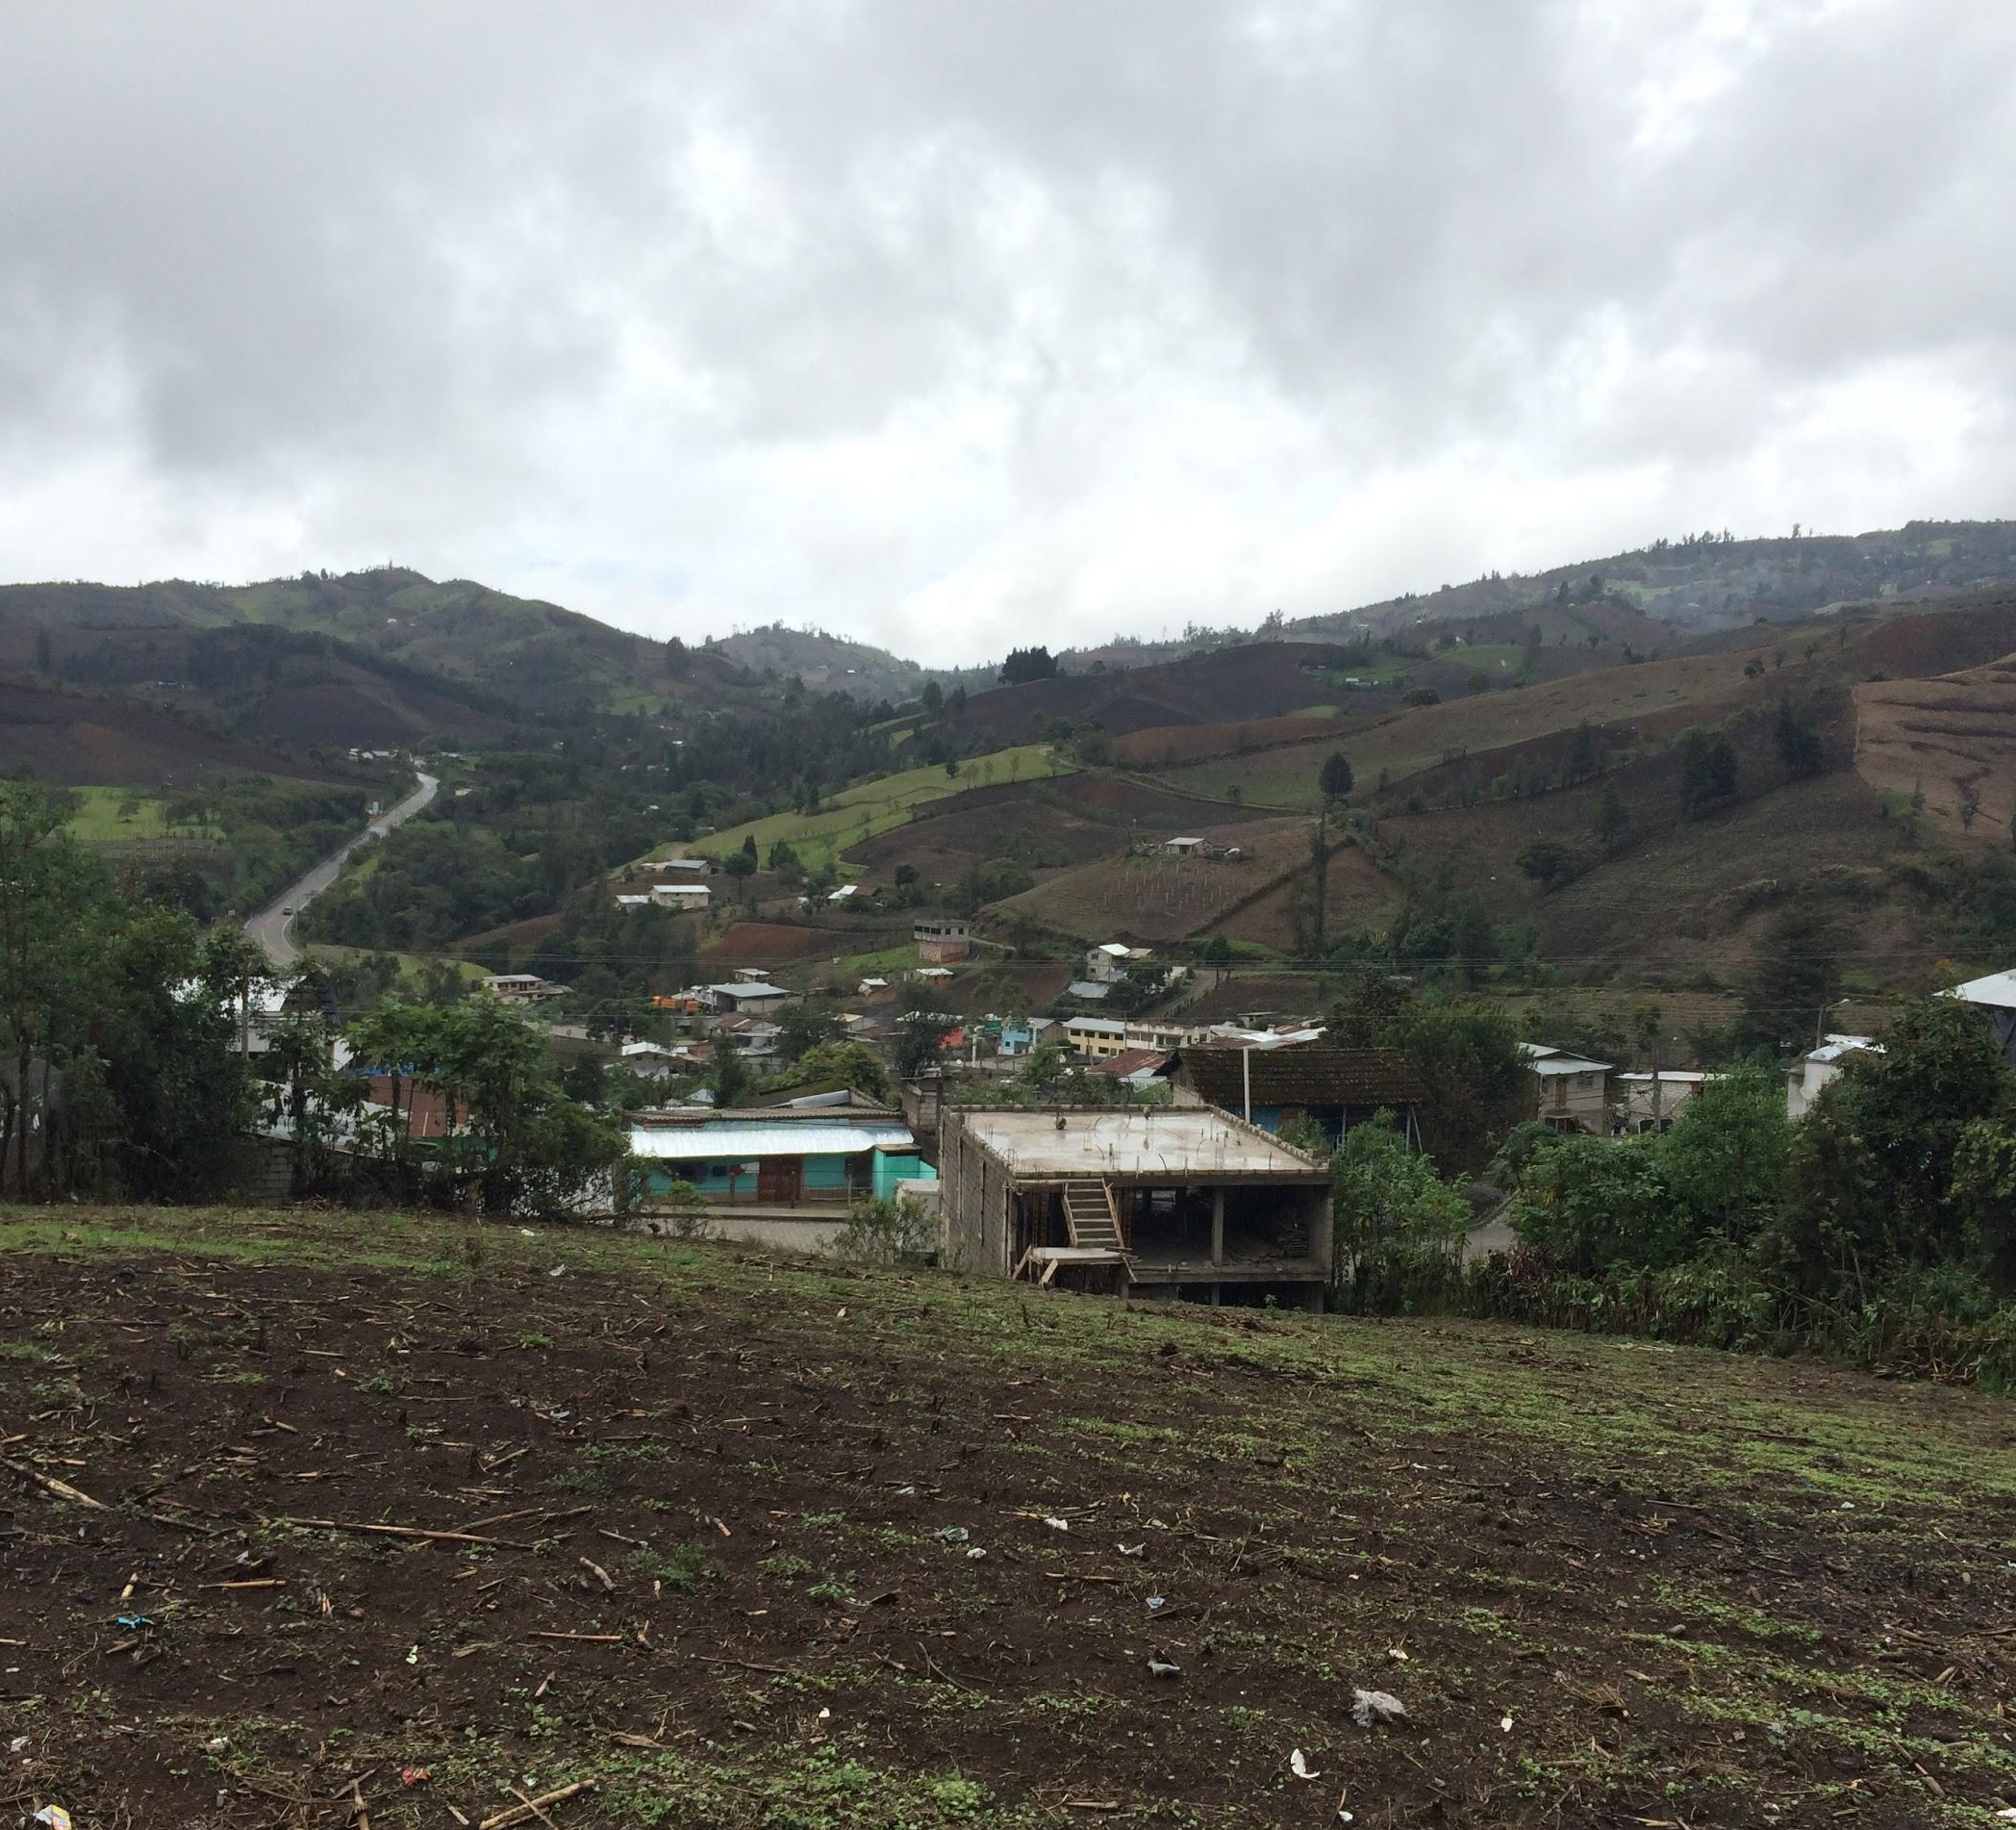
Next Steps
Notes:
We hope to provide objective technical information to set a methodological standard for environmental impact studies in other similar projects. writing a “methodology” paper.
Find domain for website
More broadly, a project like this can be a model for generating the data that is needed for the just apportionment and efficient use of water anywhere that there is competition for scarce water resources.
juxtaposition between new technologies and agrarian society
Getting to know the farmers in the communities that we visited in Ecuador, has made this project even more meaningful to our team. We hope that our project has a lasting impact on the community by providing them with information necessary to get their water rights back.
stephanie- working on obtaining better survey results and data will be analyzed throughout the summer (??).
- move away from agrarian society to a more modern and sustainable way of living/farming.
- with methodology and standards applications in the future, we can help promote sustainable practices and use standards in future environmental projects.

