Slide 1
Re-Imaging and Re-Imagining Choreometrics
Kate Spanos | Sargoon Nepaul
Drew Barker | Christina Banalopoulou
Emma Sessions | Karen Bradley : Faculty
The Future of Information Alliance, Presented at University of Maryland

Slide 2
What is Choreometrics?
What are the imaginable possibilities of Choreometrics?
The website: www.reimaginechoreometrics.com
Where did this project take us?
Overview
The Future of Information Alliance, Presented at University of Maryland

Slide 3
“Unless we take action now, what remains of human cultural variety will vanish” – Allen Lomax
History
Criticism
The Future of Information Alliance, Presented at University of Maryland

Slide 4
Present
Interviews with:
Betsy Peterson, Library of Congress
Todd Harvey, Library of Congress
Anna Lomax Wood, Association for Cultural Equity in NY
Forrestine Paulay, in NY
Visiting Collections: Library of Congress
Seeing artifacts and data
The Future of Information Alliance, Presented at University of Maryland

Slide 5
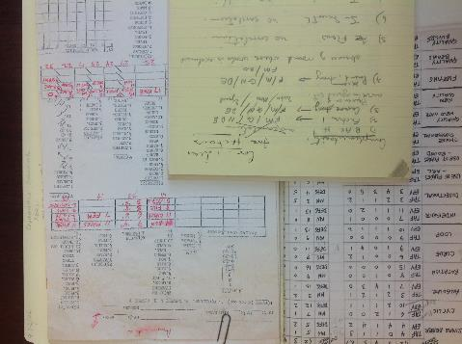
Present
OBJECTIVES:
Develop a glossary of terms for a great breadth of video analysis
Construct a website
www.reimaginechoreometrics.com
The Future of Information Alliance, Presented at University of Maryland

Slide 6
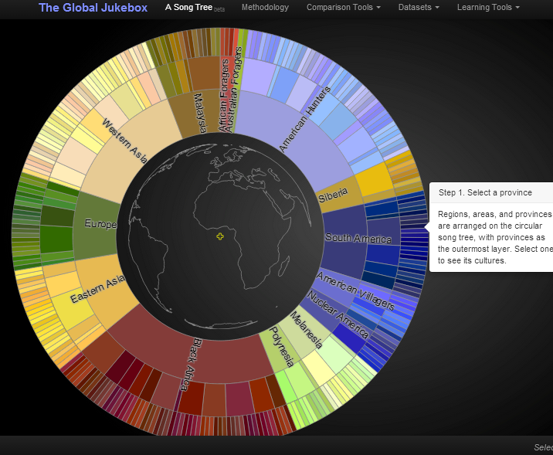
Future
http://culturalequity.org/dev/gjb-tree.html
Association of Cultural Equity- Beta Global Song Tree.
Cantometrics
The Future of Information Alliance, Presented at University of Maryland

Slide 7
Possibilites
Accessibility
Searchability
Repatriation

Slide 8
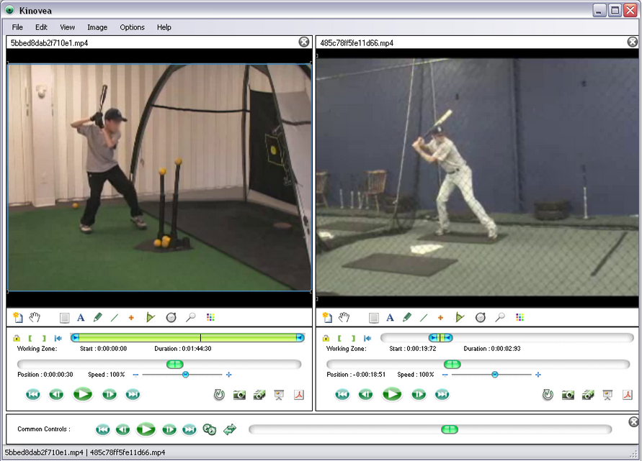
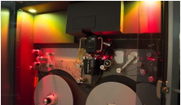
Tangibility
Comparability: Kinovea
Searchability:
Tagging and Meta Tagging
The film company British Pathé digitized over 90,000 films and clips and made them searchable
Digitization services:
ex. Colorlab- specializing in 16mm films
The Future of Information Alliance, Presented at University of Maryland

Slide 9
Beginning Again, through Digitization
Former sponsors:
National Endowment for the Humanities
National Institute of Health
Rockefeller Foundation
Ford Foundation
National Science Foundation
We now need help over the final, massive hurdle:
the price of digitization.
The Future of Information Alliance, Presented at University of Maryland

Slide 10
The Future Possibilities of Choreometrics
If this massive digitization initiative is funded, then we will see each other more clearly through dance.
If the film elements can be digitized, then the Global Jukebox can be accessed and the dances returned to those who dance them. If this 20th century project can be realized through 21st century technology, our century will better know human history through dance.

