Slide 1
Teaching Girls Online Skills for Knowledge Creation
-Deutsch Seed Grant Project
Team:
Stine Eckert
Linda Steiner
Kalyani Chadha
Joanna Margueritte-Giecewicz
Kristen Sabatini
Angelisa Plane
and Jessica Roberts

Slide 2
FIA Priorities - Issue
PROBLEM: only 12.6% Wikipedia contributors are women (Glott & Ghosh, 2010)
More broadly, only 18% of Computer Science graduates are women (NCWIT, 2010)
Early participation in and control over creation of new technology is crucial
EQUITY
LITERACY
TRANSFER

Slide 3
FIA Priorities - Solution
Online & multimedia skills:
Useful in both educational and job contexts, making IT sphere accessible
Help to boost confidence
speak out on online platforms
Help to improve self-perception
be able to teach others, become an expert

Slide 4
WikidGRRLs: Feb 5 – May 6, 2013
Our project in numbers:
1 independent Wiki platform
wikispaces.com/wikidgrrls
3 public and 1 private (official partner – Barrie School)
7-9 weeks of 1 hour workshops
36 girls of diverse backgrounds

Slide 5
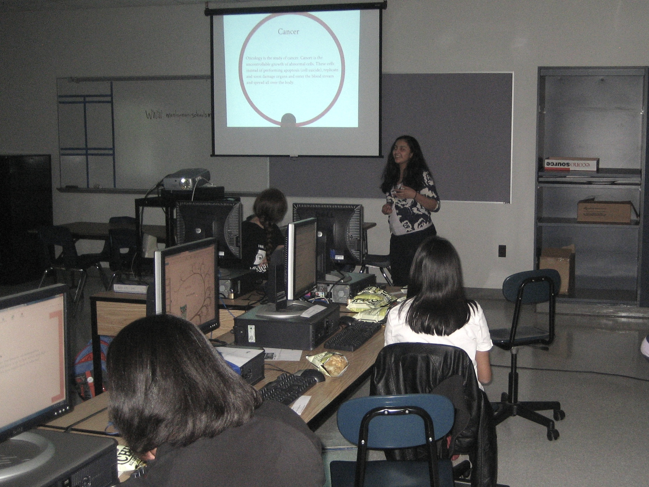

Slide 6
Pre-workshop survey: Findings
Our students use computers and internet from age 5
65% have their own computer, 60% have smartphones with internet access
Most participants know how to search on Google and share images
While interpersonal communication skills are high, knowledge-sharing and creation skills are low
Only 40% of girls knew what a Wiki is or how to create an online survey

Slide 7
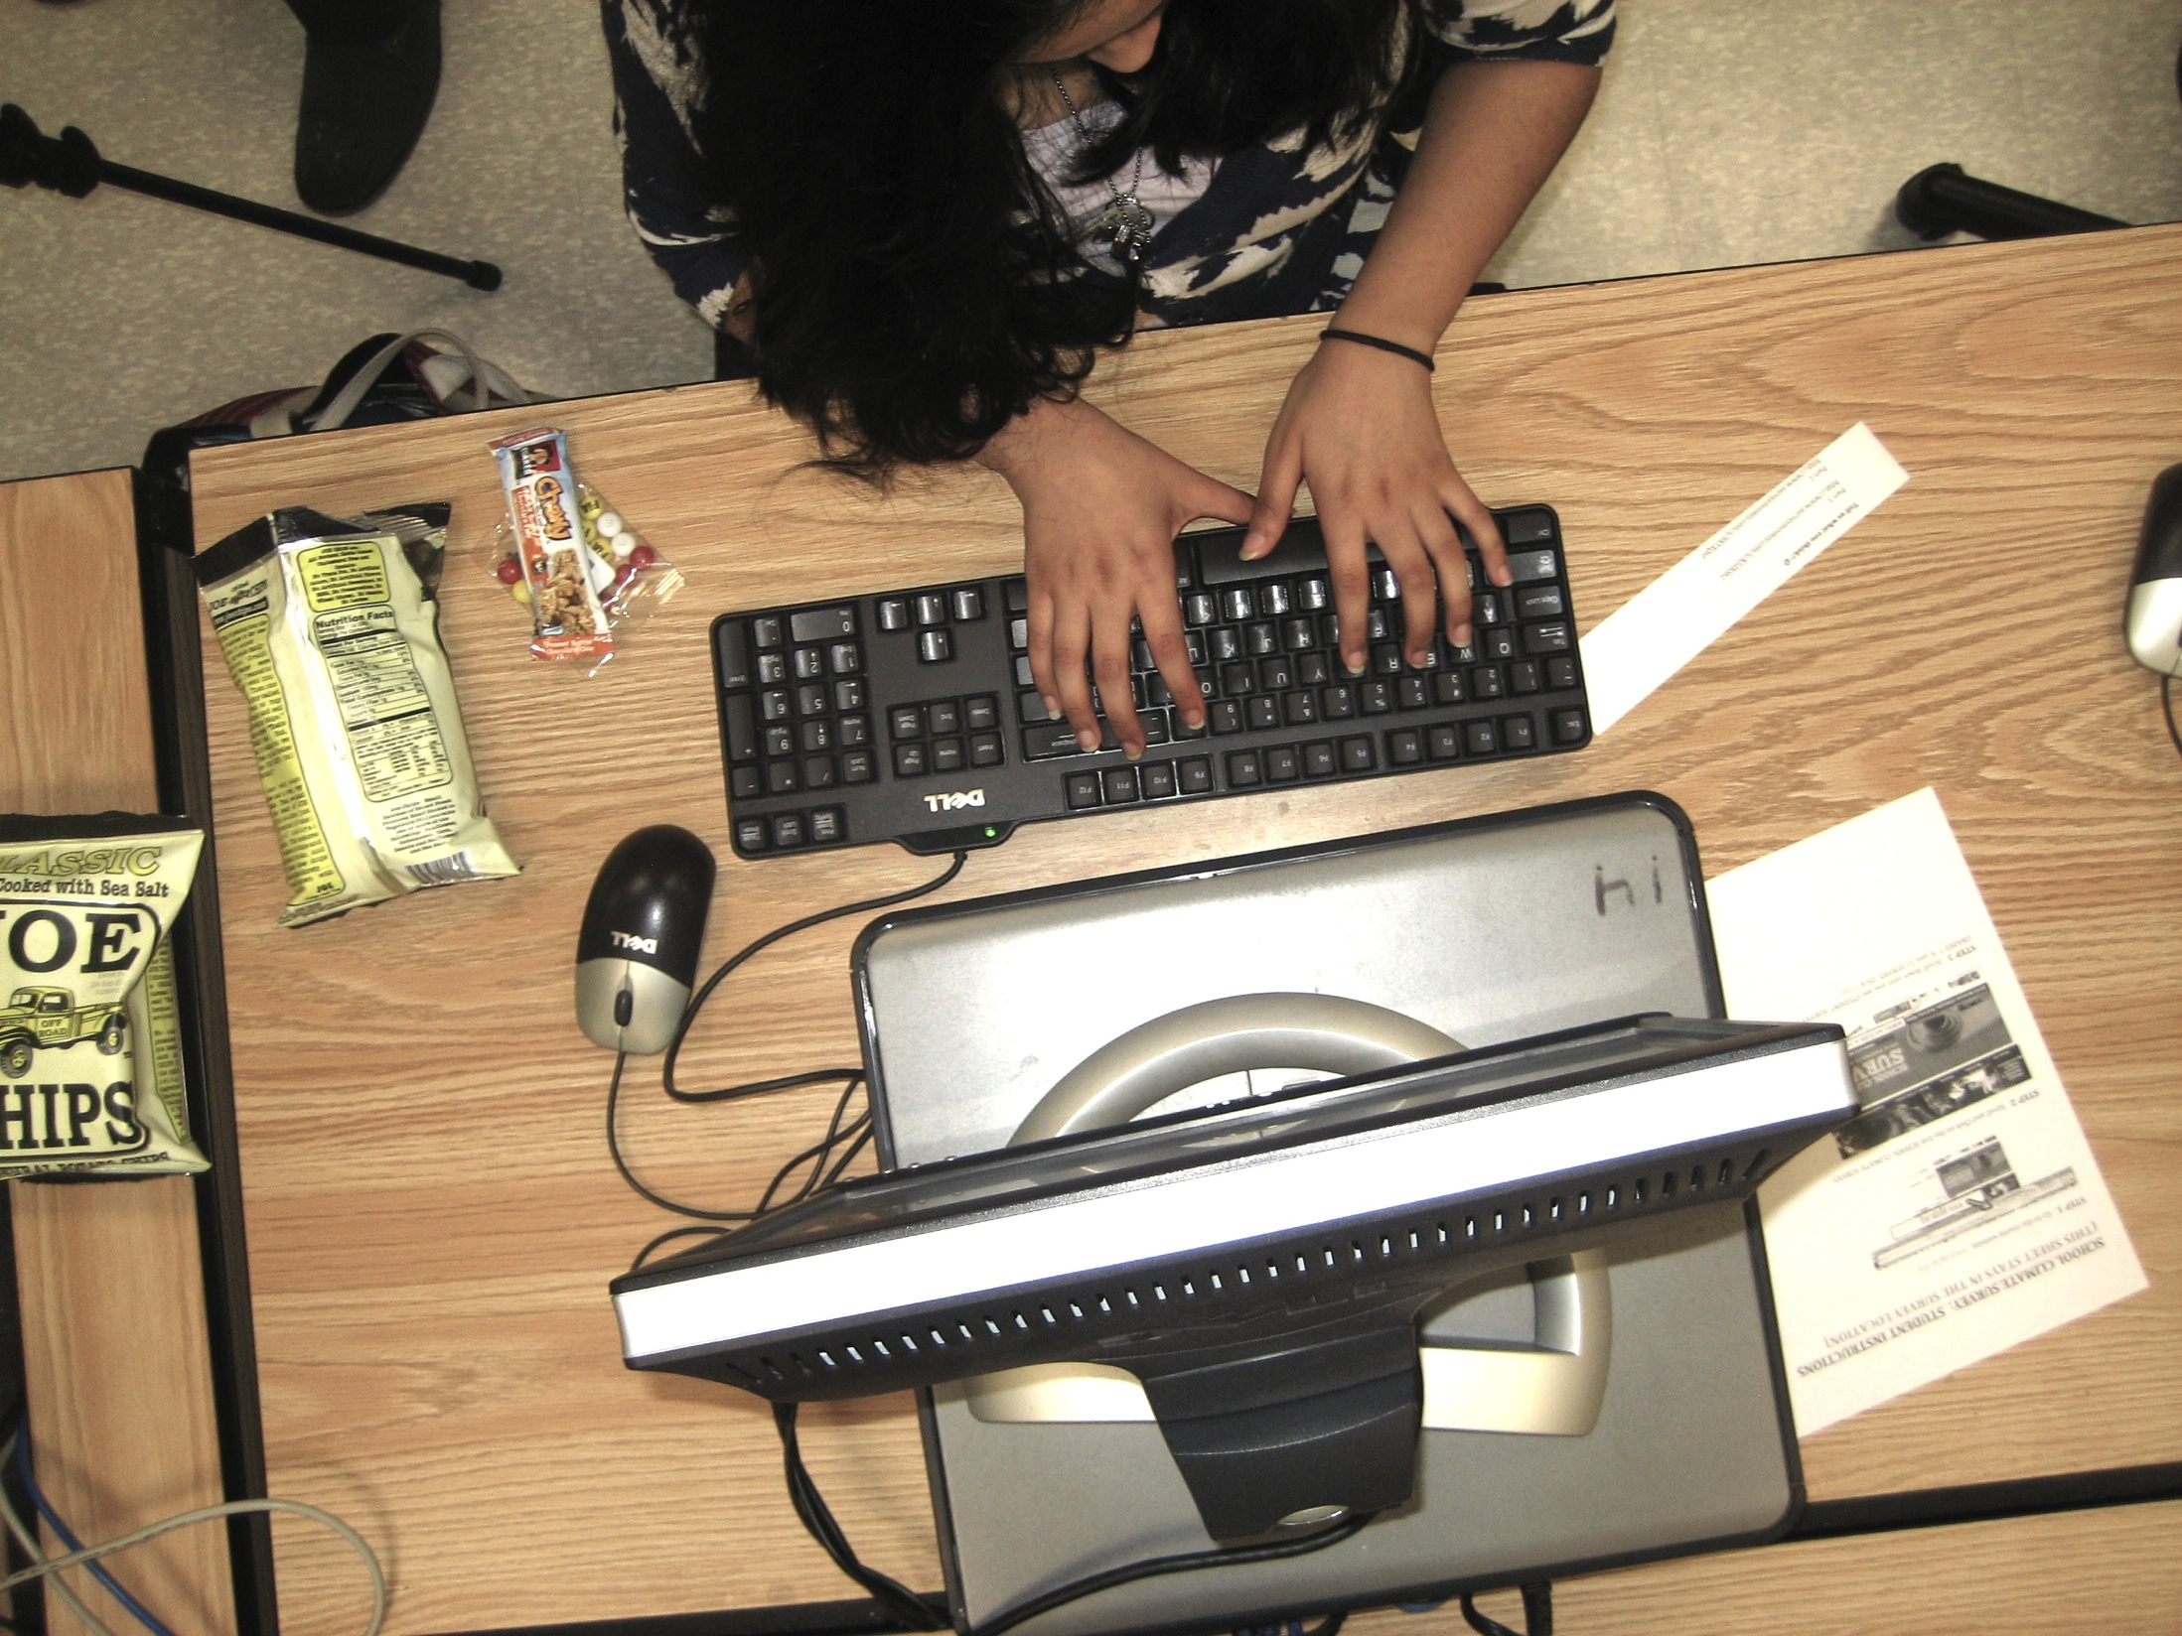
Greenbelt Middle

Slide 8
Process & Strategies
Direct contact with partners in each school, establishment of working space and recruitment of girls
Team blog at blog.umd.edu/wikidgrrls, tweeting & publicizing
Over a period of 10 weeks, team members met four times in order to discuss lesson plans in detail (consistent across the four schools)
Skills taught were applied directly to the creation of articles on the private Wikispace
Girls from each school could see the progress made by everyone else in the project

Slide 9
Barrie School

Slide 10
Skills Taught
Article creation, content elaboration through online search
Evaluating sources and proper citation
Collaboration with other users, civility, constructive criticism
Use of data-mining tools such as Google Trends or building online surveys
Use of innovative presentation software (Prezi)
Embedding HTML code into articles
Copyright issues online (use of images, Creative Commons)

Slide 11
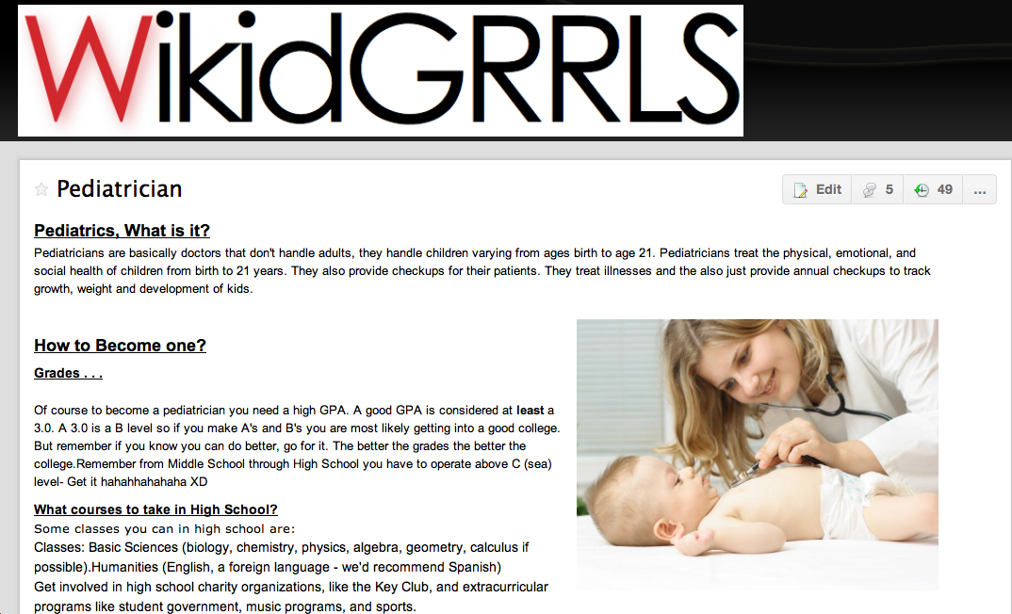
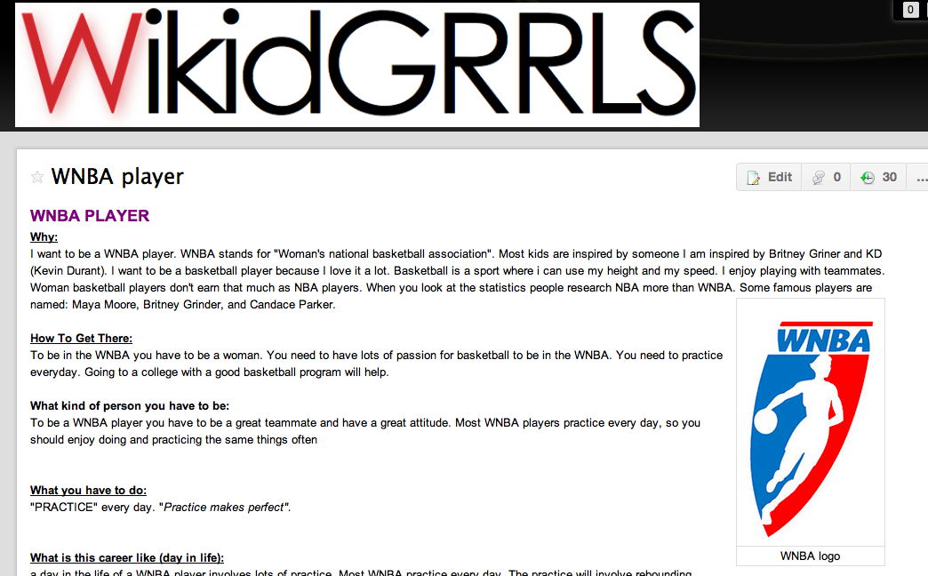
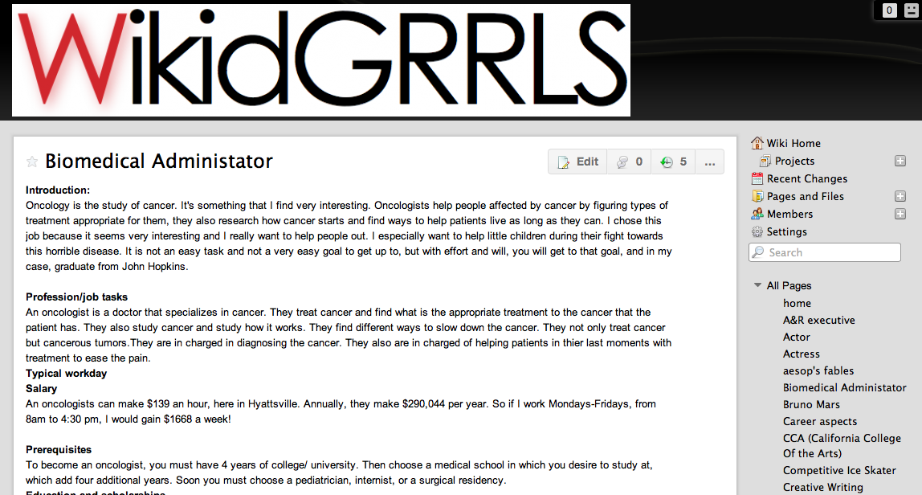
Example articles
Girls wrote articles about possible future careers they would like to pursue

Slide 12
Lessons Learned
Time between attribution of grant and first workshop session very limited
Establishing time & place for extracurricular activity is a lengthy process, especially in public schools
Girls’ commitment is not easy to ensure
Passion for learning, enthusiasm and aptitude for online skill building are unlimited
Challenge: teaching these skills to girls while keeping it interactive & fun

Slide 13
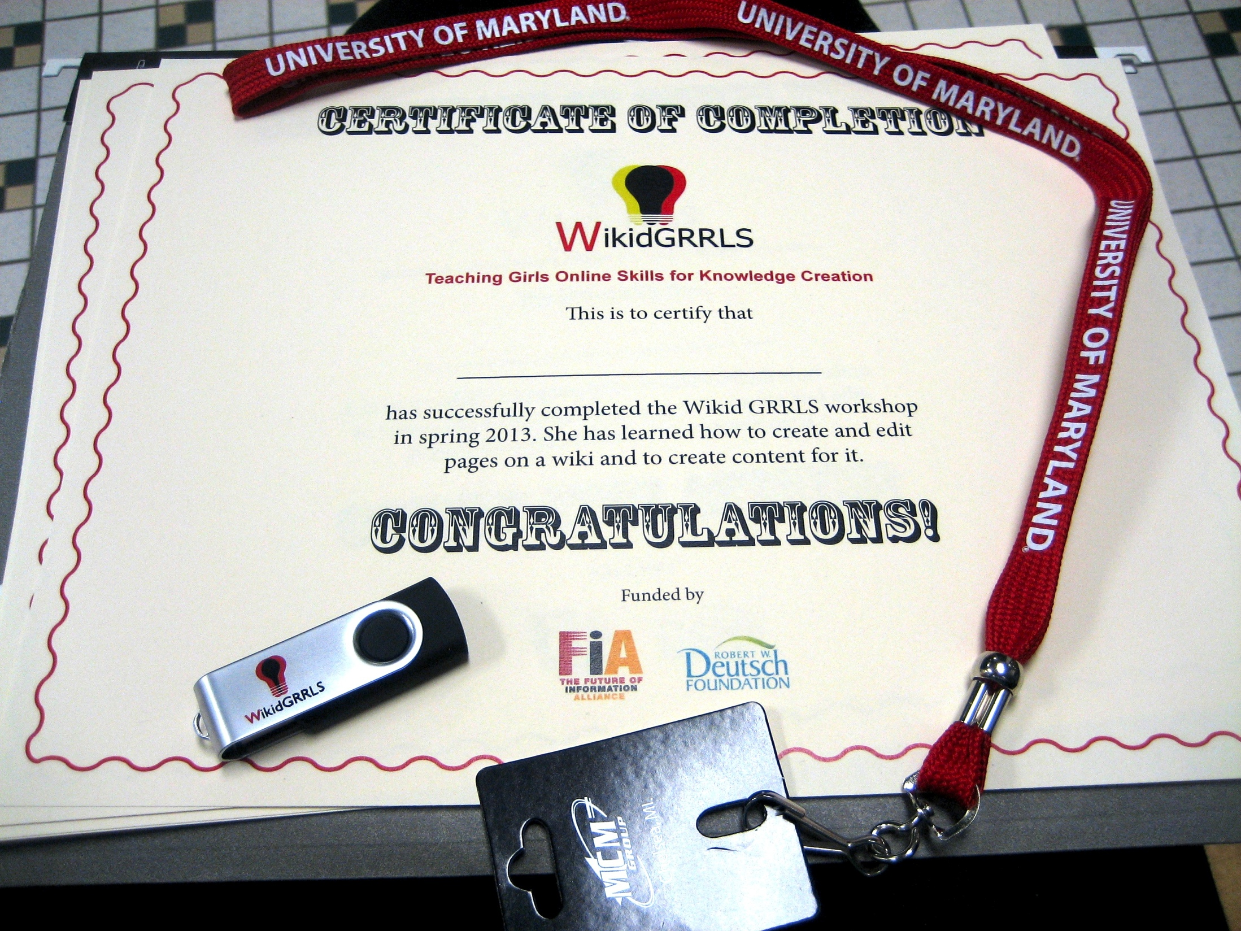

Slide 14
Next Steps
Along with “Girls Tech” at Sligo School, this is a valuable and all too rare initiative
Curriculum must be developed in more detail to ensure transferability to other schools
Recruitment in future schools should be even more open & inclusive
We believe our workshop has made a difference in how students perceive their expertise as potential sources of knowledge
Levels of confidence and ease with online tools have risen

Slide 15
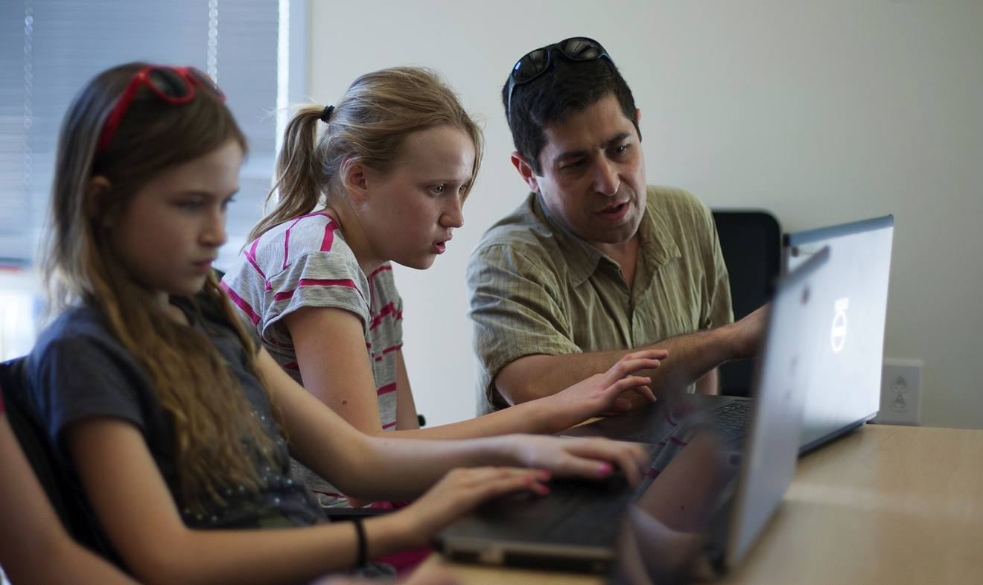
Thank you – and a message from our partner

