Slide 1
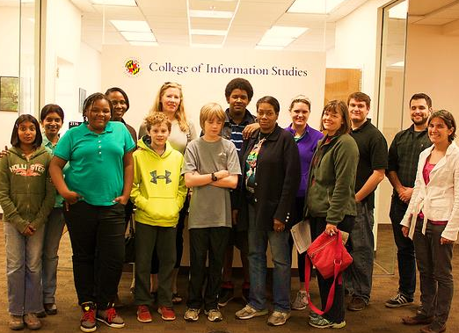
Safe Space and Knowledge Discovery:
Social Media in the National Parks
Mega Subramaniam, Claire Valdivia, Tony Pellicone, Zach Neigh, Mandy Lowman

Slide 2
YOUTH ENGAGEMENT IN THE PARKS
IN PERSON
PARK SPECIFIC

Slide 3
YOUTH ENGAGEMENT IN THE PARKS
IN PERSON
PARK SPECIFIC
ONLINE
INDIVIDUAL ACTIVITIES

Slide 4
YOUTH ENGAGEMENT IN THE PARKS
ONLINE COMMUNITY
?
IN PERSON
PARK SPECIFIC
ONLINE
INDIVIDUAL ACTIVITIES
TWEENS SEEK
SOCIAL COMPONENT
“
”
Hiya! I'm Kate and I.... i dont know what to say! I LOVE Webrangers! I am new BUT i have FOUR awards already! Who else likes Webrangers?”

Slide 5
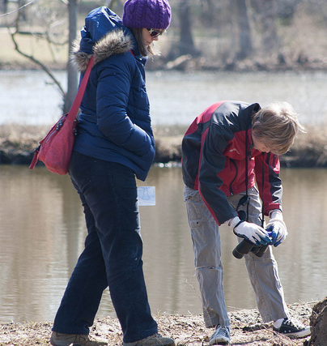
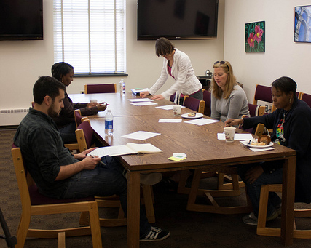
PROJECT PRIORITIES
PRIVACY

Slide 6
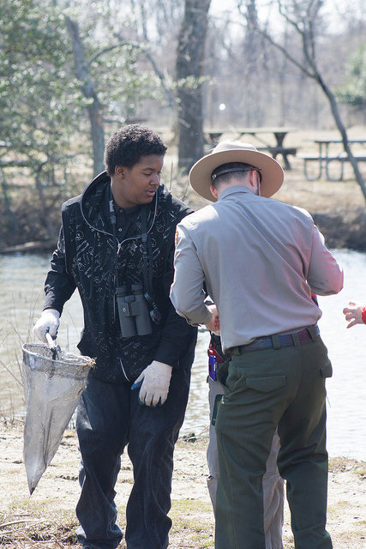
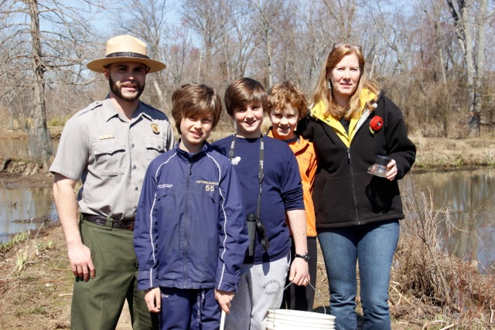
PROJECT PRIORITIES
INFOTRANSFER

Slide 7
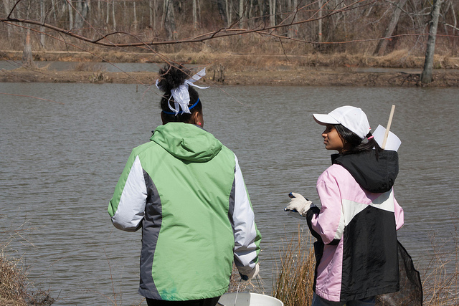
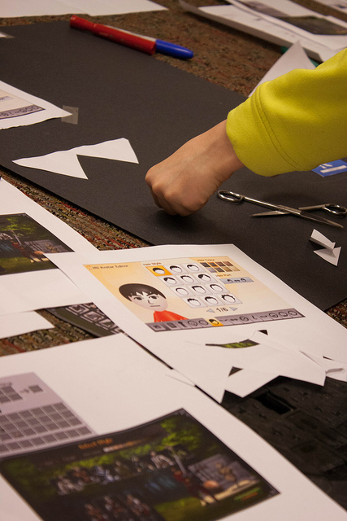
PROJECT PRIORITIES
INFOEQUITY

Slide 8
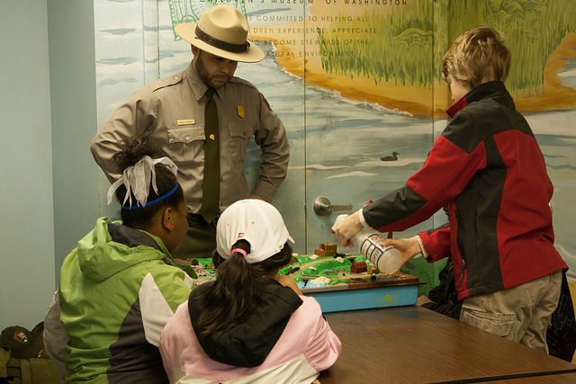
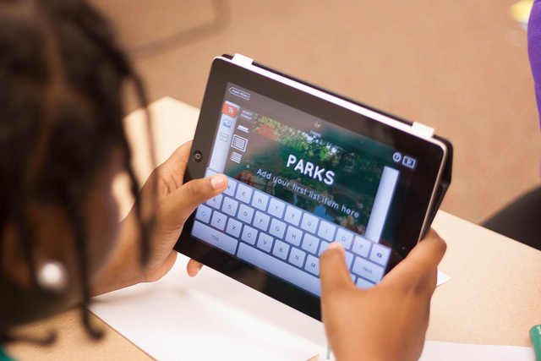
PROJECT PRIORITIES
INFOLITERACY

Slide 9
CONNECTED LEARNING
PERSONALLY RELEVANT
FRIENDSHIP AND INTEREST DRIVEN
LEARNING EXTENDS BEYOND PHYSICAL PARK SPACE
researchresults.wordpress.com

Slide 10
The most important thing is [having] fun
Let kids join, but monitor their accounts and if anything bad is said by or to them, ban whoever said it
Give kids the space to do what they want. Don’t block everything
WHAT IS IMPORTANT TO TWEENS?

Slide 11
I’m trying to impress upon my son an openness and trust with people in general but not to give away that kind of information online and that’s a really difficult thing for him to understand for him right now
WHAT KEEPS PARENTS UP AT NIGHT?
And the bullying aspect that they keep talking about in the media, so we just don’t [participate in social media].

Slide 13
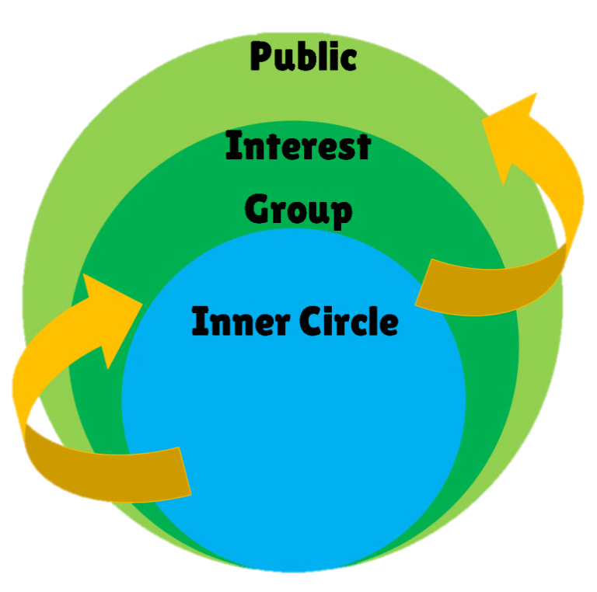
LAYERED PRIVACY

Slide 14
EMPOWERED COMMUNITY

Slide 15
PARENTAL INVOLVEMENT

Slide 16
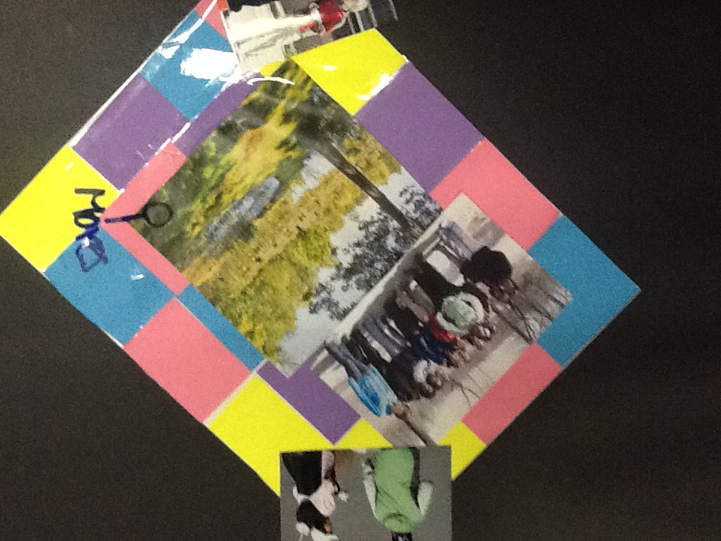
DYNAMIC CONTENT
CONNECTED MEDIA

Slide 17
PERSONALIZATION
REPUTATION

Slide 18
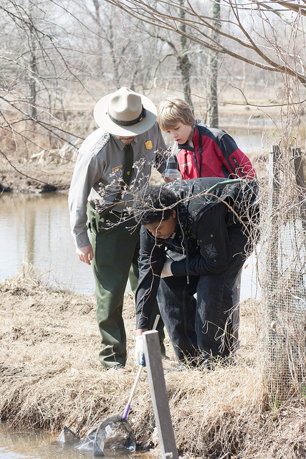
BRINGING IT ALL TOGETHER
PROMOTE SAFE AND POSITIVE ONLINE CULTURE
CREATE NEW AVENUES FOR LEARNING SCIENCE
BRING TOGETHER THE JUNIOR RANGER COMMUNITY

Slide 19
DISSEMINATION
iConference
Digital Youth Summit
After publishing, spreading publically via NPS site and social media (Twitter, etc.)
NEXT STEPS
Google Research Awards
National Park Foundation

Slide 20
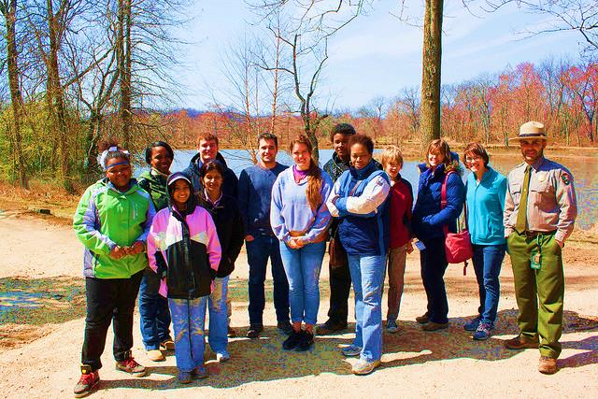
THANK YOU!
Future of Information Alliance Team
Deutsch Foundation
The National Park System
Kenilworth Park and Aquatic Gardens
Our parents and tween participants
Rebecca Follman for her photography and volunteering.

